Slide 1
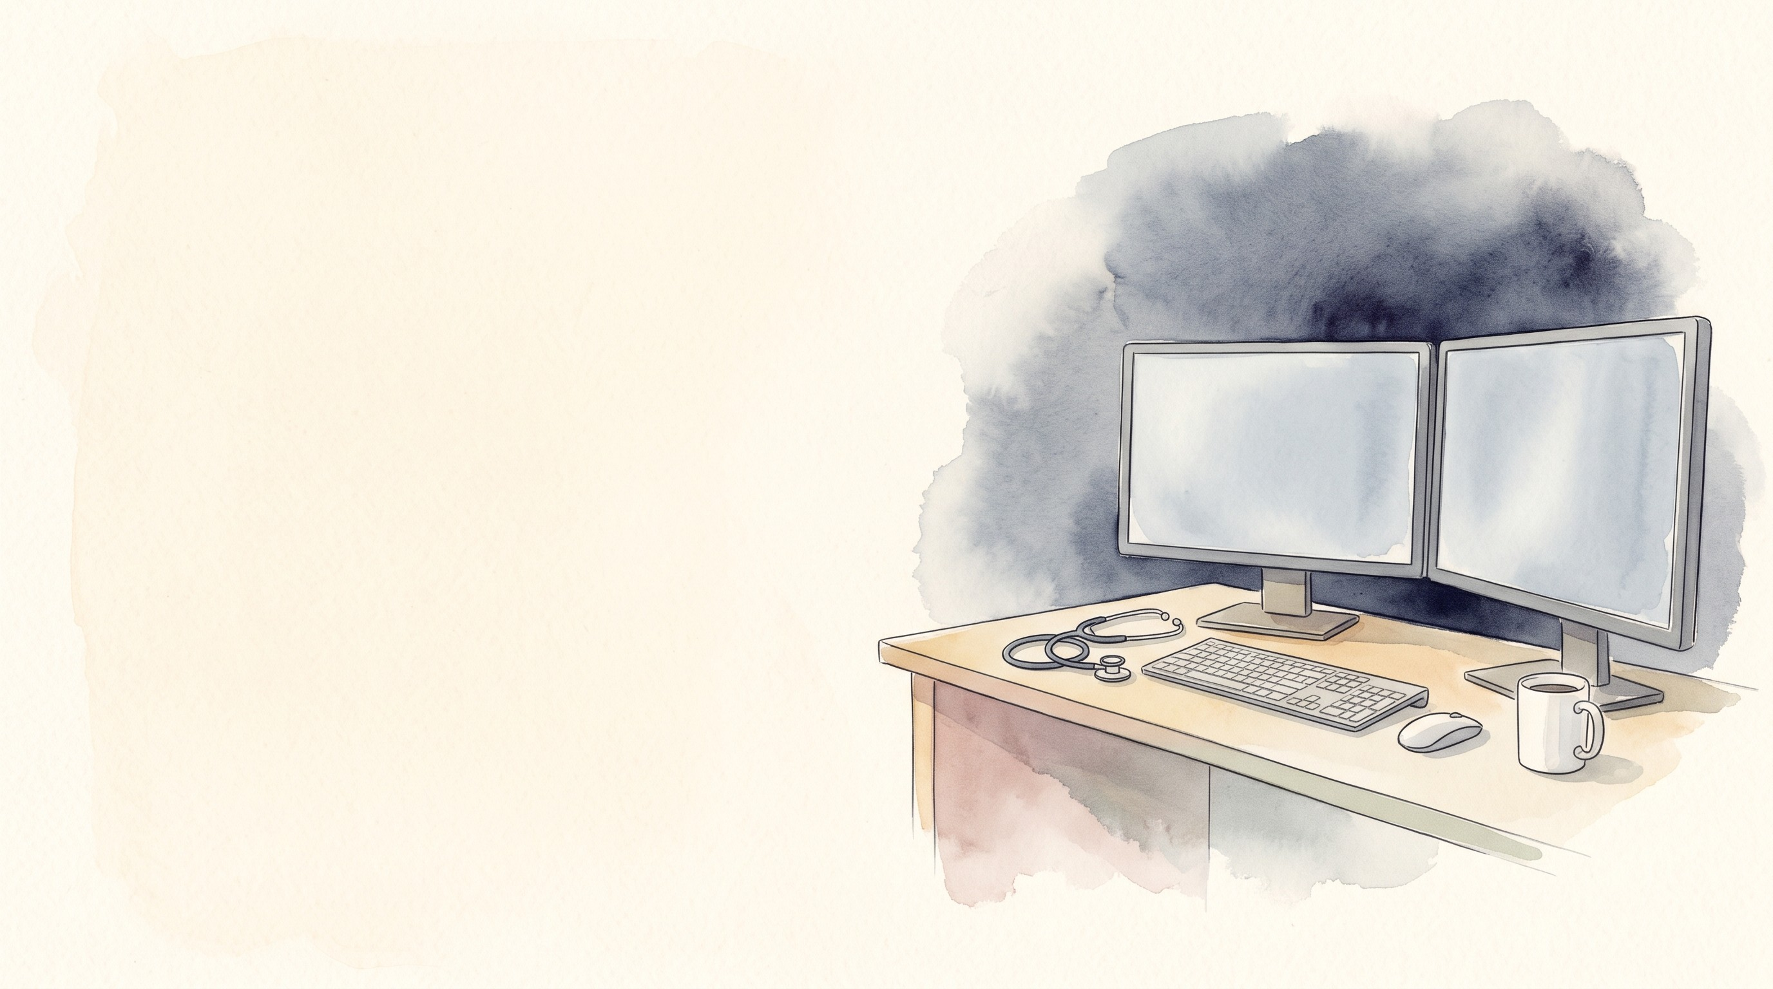

Epically Efficient
Electronic Health Record Tools
to Improve Your Practice
Mohammad Almeqdadi, MD
Transplant Hepatologist and Gastroenterologist
Assistant Professor of Medicine and Surgery
X: @mfalmeqdadi
Illustrations generated with Google Gemini
Notes:
20 minutes, 10:10 to 10:30. Emily has already said why this session exists, so no burnout slides up front. Nizar covers ambient documentation in depth, so I only touch it once. Show and tell, no live demo. Every screen in this talk is a mock-up with made-up data.

Slide 2

Disclosures
No relevant financial relationships
No relationship with Epic Systems
Every screen in this talk is a mock-up with invented data. None of it is a real patient or a real Epic screen
1/26
Notes:
Quick. The point to make: the screens look like Epic so you recognize them, but I drew them. No patient data anywhere.

Slide 3

Objectives
Find what you need in the chart faster
Spend less time on notes, orders and the In Basket
Know which AI tools are live and what the evidence shows
Measure your own EHR time
2/26
Notes:
Four things. We'll follow one new referral through the chart, then the In Basket, then the AI tools, then how to see your own numbers.

Slide 4
Why Epic?
What share of US transplants were done at a center using Epic's transplant module?
Epic UGM 2025, source OPTN. 48,137 US transplants in 2024; 49,064 in 2025. Epic's transplant module is called Phoenix
3/26
Notes:
Ask the room to guess. Most guess around half. 82% of US transplants in 2024 and 86% in 2025 were done at a center on Phoenix, and another 6% are at centers implementing it. So most hepatologists in this room work in Epic, and that's why the tool names in this talk are Epic's. Source: Epic UGM 2025 transplant breakout, data from OPTN.

Slide 5
Why Epic?
What share of US transplants were done at a center using Epic's transplant module?
86% in 2025, and another 6% at centers implementing it
Epic UGM 2025, source OPTN. 48,137 US transplants in 2024; 49,064 in 2025. Epic's transplant module is called Phoenix
3/26
Notes:
Ask the room to guess. Most guess around half. 82% of US transplants in 2024 and 86% in 2025 were done at a center on Phoenix, and another 6% are at centers implementing it. So most hepatologists in this room work in Epic, and that's why the tool names in this talk are Epic's. Source: Epic UGM 2025 transplant breakout, data from OPTN.

Slide 6
And everyone else?
Most of these tools have a version in the other systems
VA: CPRS. VA GPT is a general chat tool approved for PHI, used by over 15,000 staff. It is not built into CPRS
KLAS via Becker's Hospital Review, 2022 (share of US hospitals). VA OIG report 26-00182-140, June 2026
4/26
Notes:
One fair sentence on the others; no jokes about anyone's system. The ideas carry over even when the names don't. VA GPT came up in our planning call as a CPRS tool. It isn't: the VA OIG reviewed it in June 2026 as a general chat tool approved for PHI, separate from CPRS. The VA ambient scribe is a separate pilot.

Slide 7
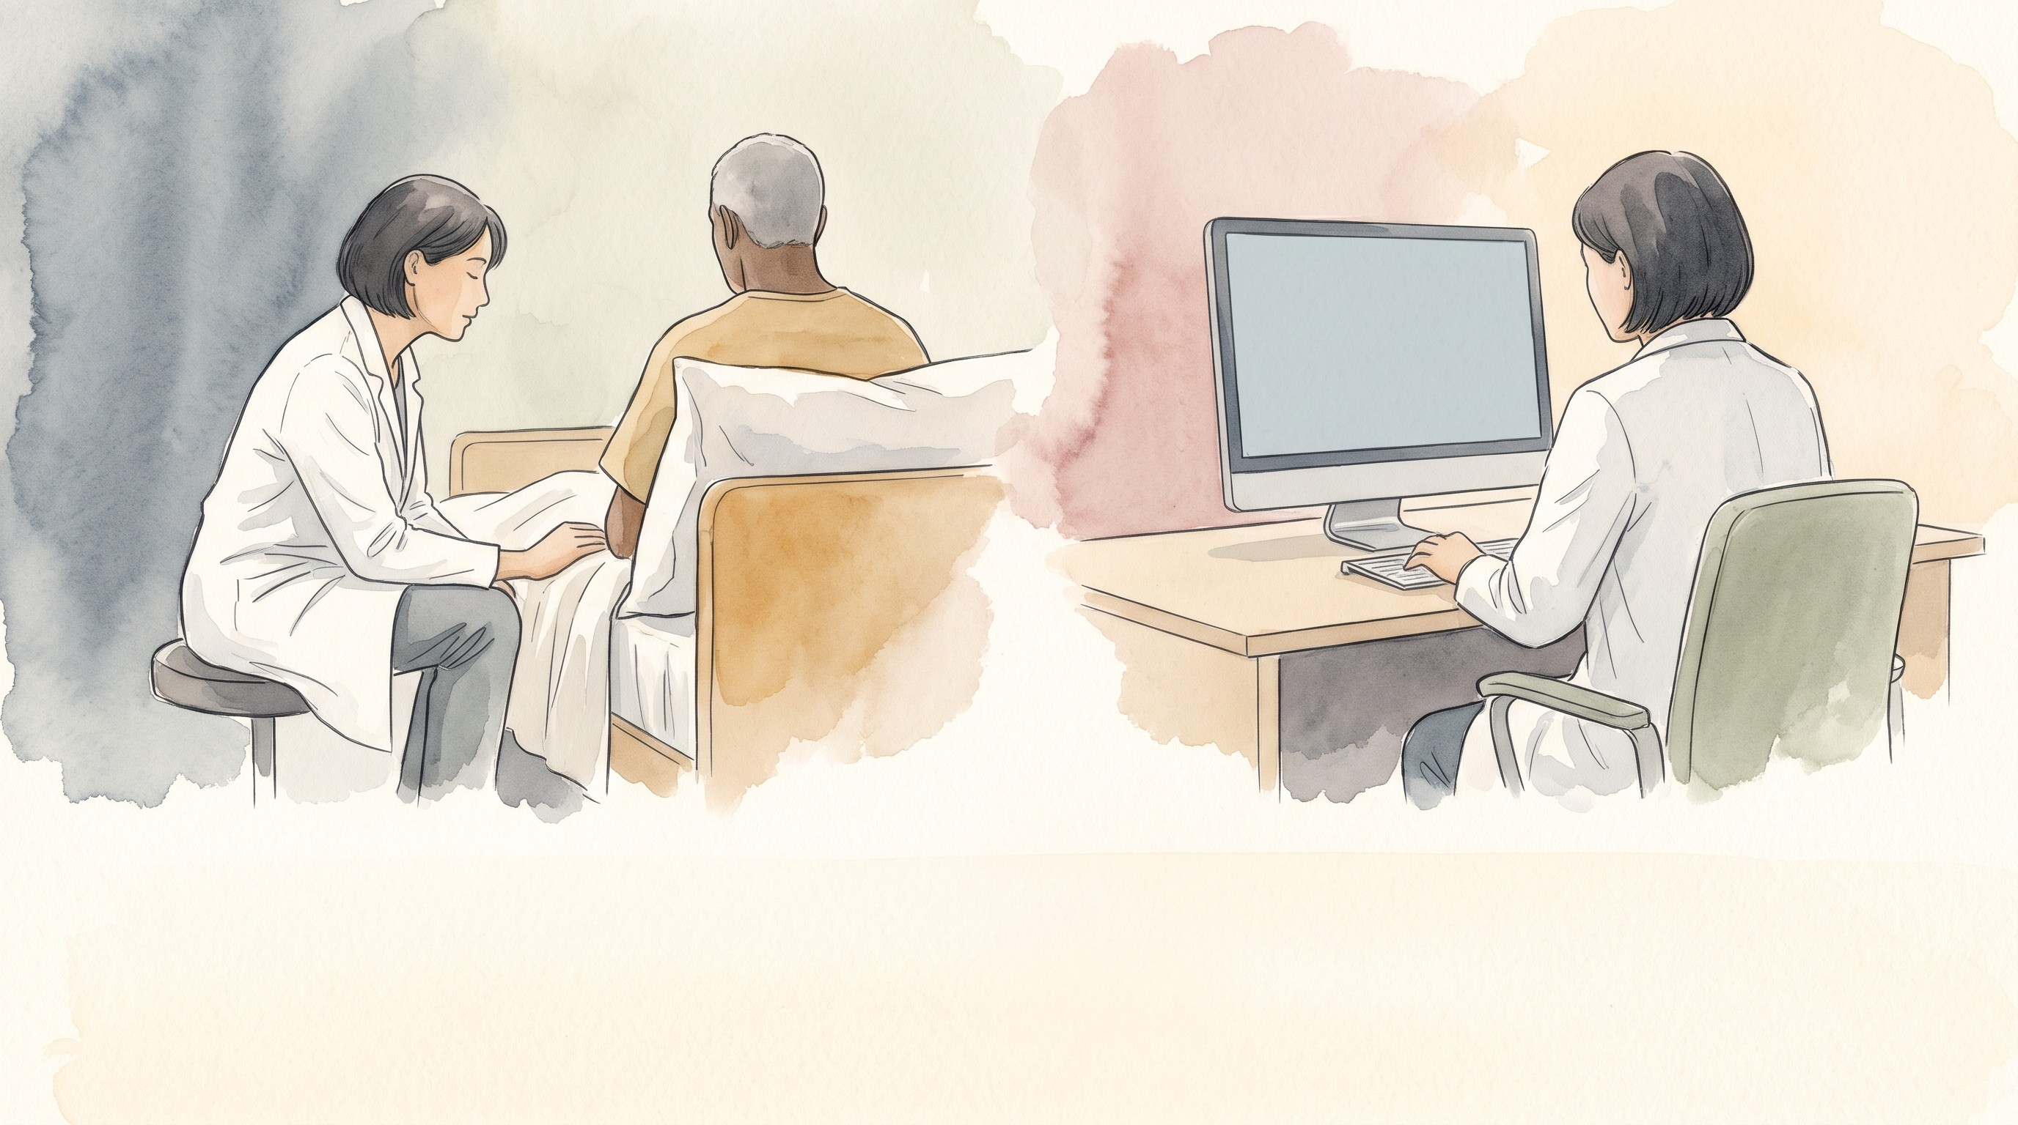
We used to call the resident who got the whole story from the patient a good historian.
5/26
Notes:
I say this to my trainees all the time. Taking a history from the patient is still the job. But half of the history now lives in the chart, and the person who knows where to find it saves everyone time.

Slide 8
We used to call the resident who got the whole story from the patient a good historian.
Today that resident also knows where everything is in the chart.
5/26
Notes:
I say this to my trainees all the time. Taking a history from the patient is still the job. But half of the history now lives in the chart, and the person who knows where to find it saves everyone time.

Slide 9
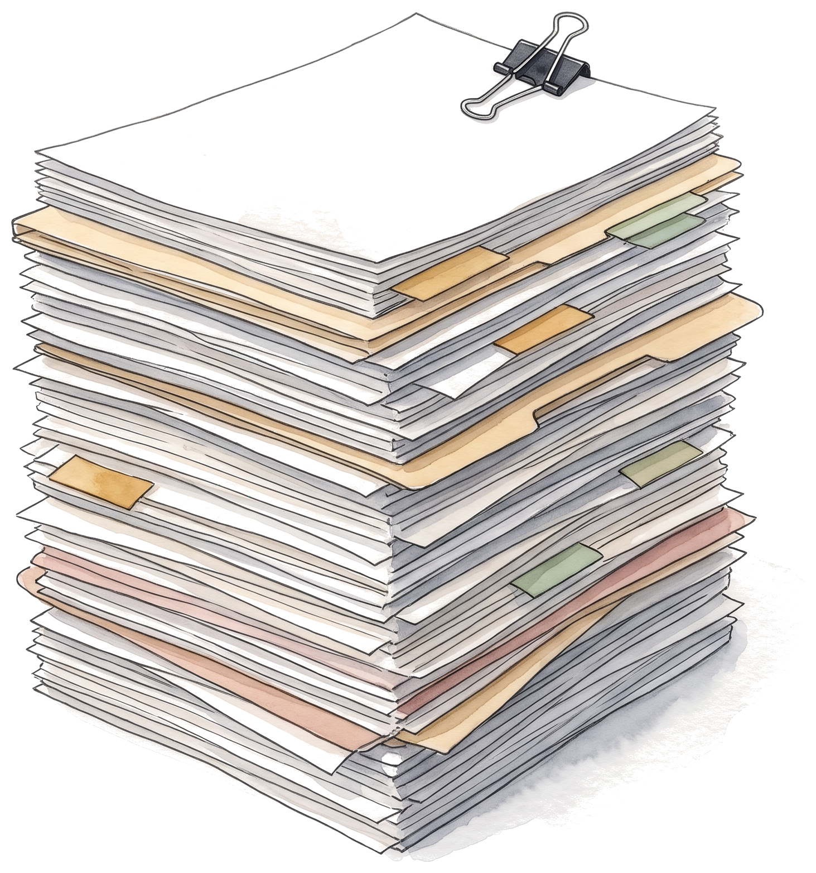
New referral
Finding information
58M with cirrhosis. 14 years of records, 312 outside documents. 10 minutes before you walk in.
What do you want to know?
6/26
Notes:
Ask the room and wait for two or three answers before going to the list. This made-up patient, ZZTEST, LIVER, carries the talk. The next five slides find each item on the list.

Slide 10
New referral
Finding information
58M with cirrhosis. 14 years of records, 312 outside documents. 10 minutes before you walk in.
What do you want to know?
Where his MELD is going
Was the etiology workup done?
Last imaging (HCC surveillance)
Last EGD (varices)
Current liver meds
Is he still drinking?
6/26
Notes:
Ask the room and wait for two or three answers before going to the list. This made-up patient, ZZTEST, LIVER, carries the talk. The next five slides find each item on the list.

Slide 11
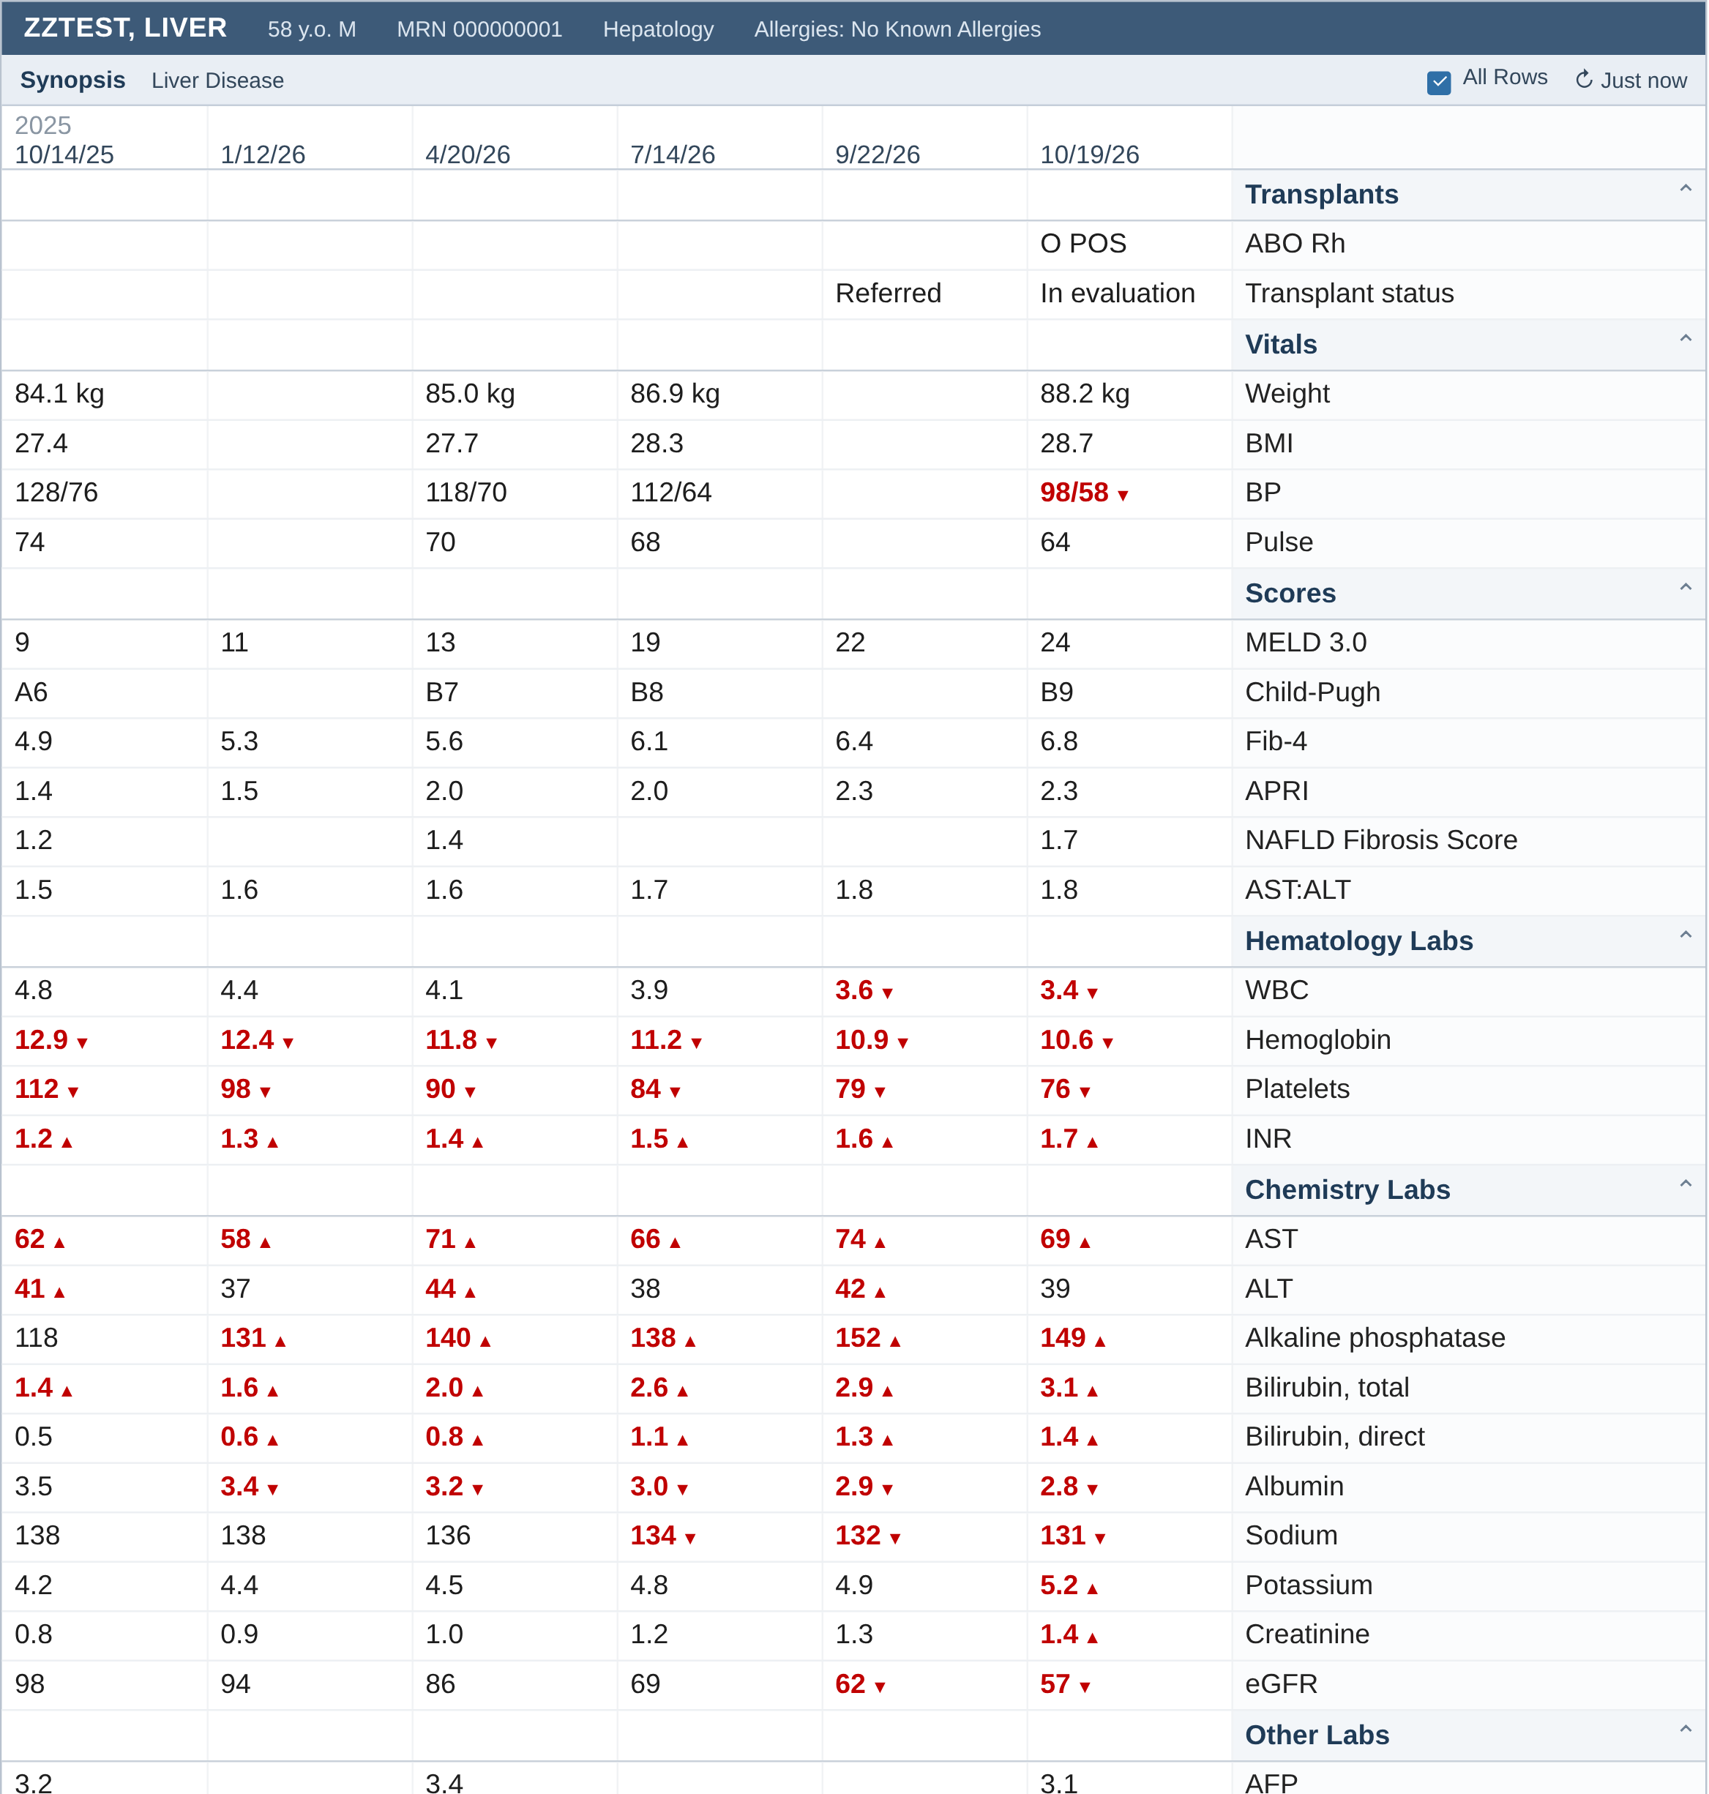
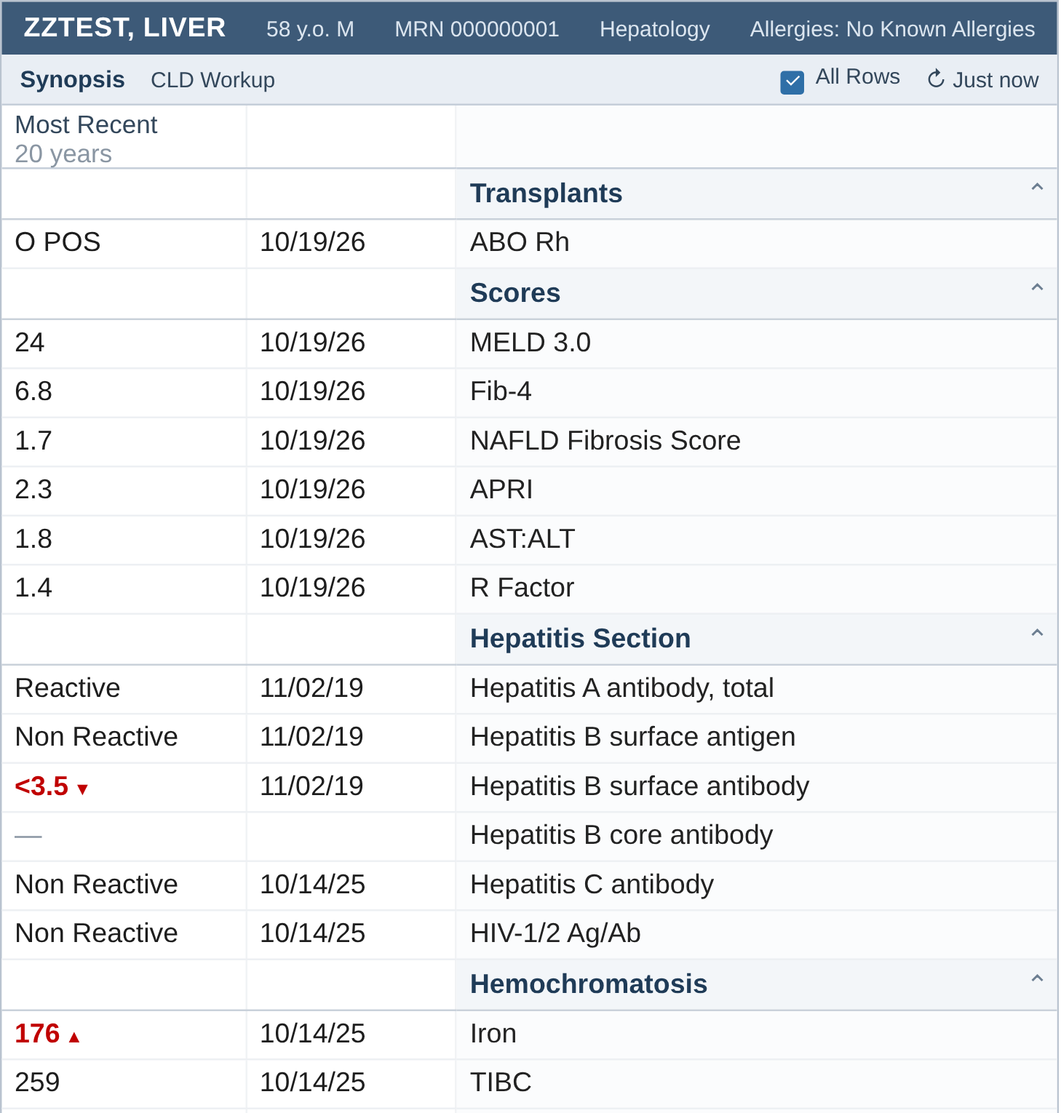
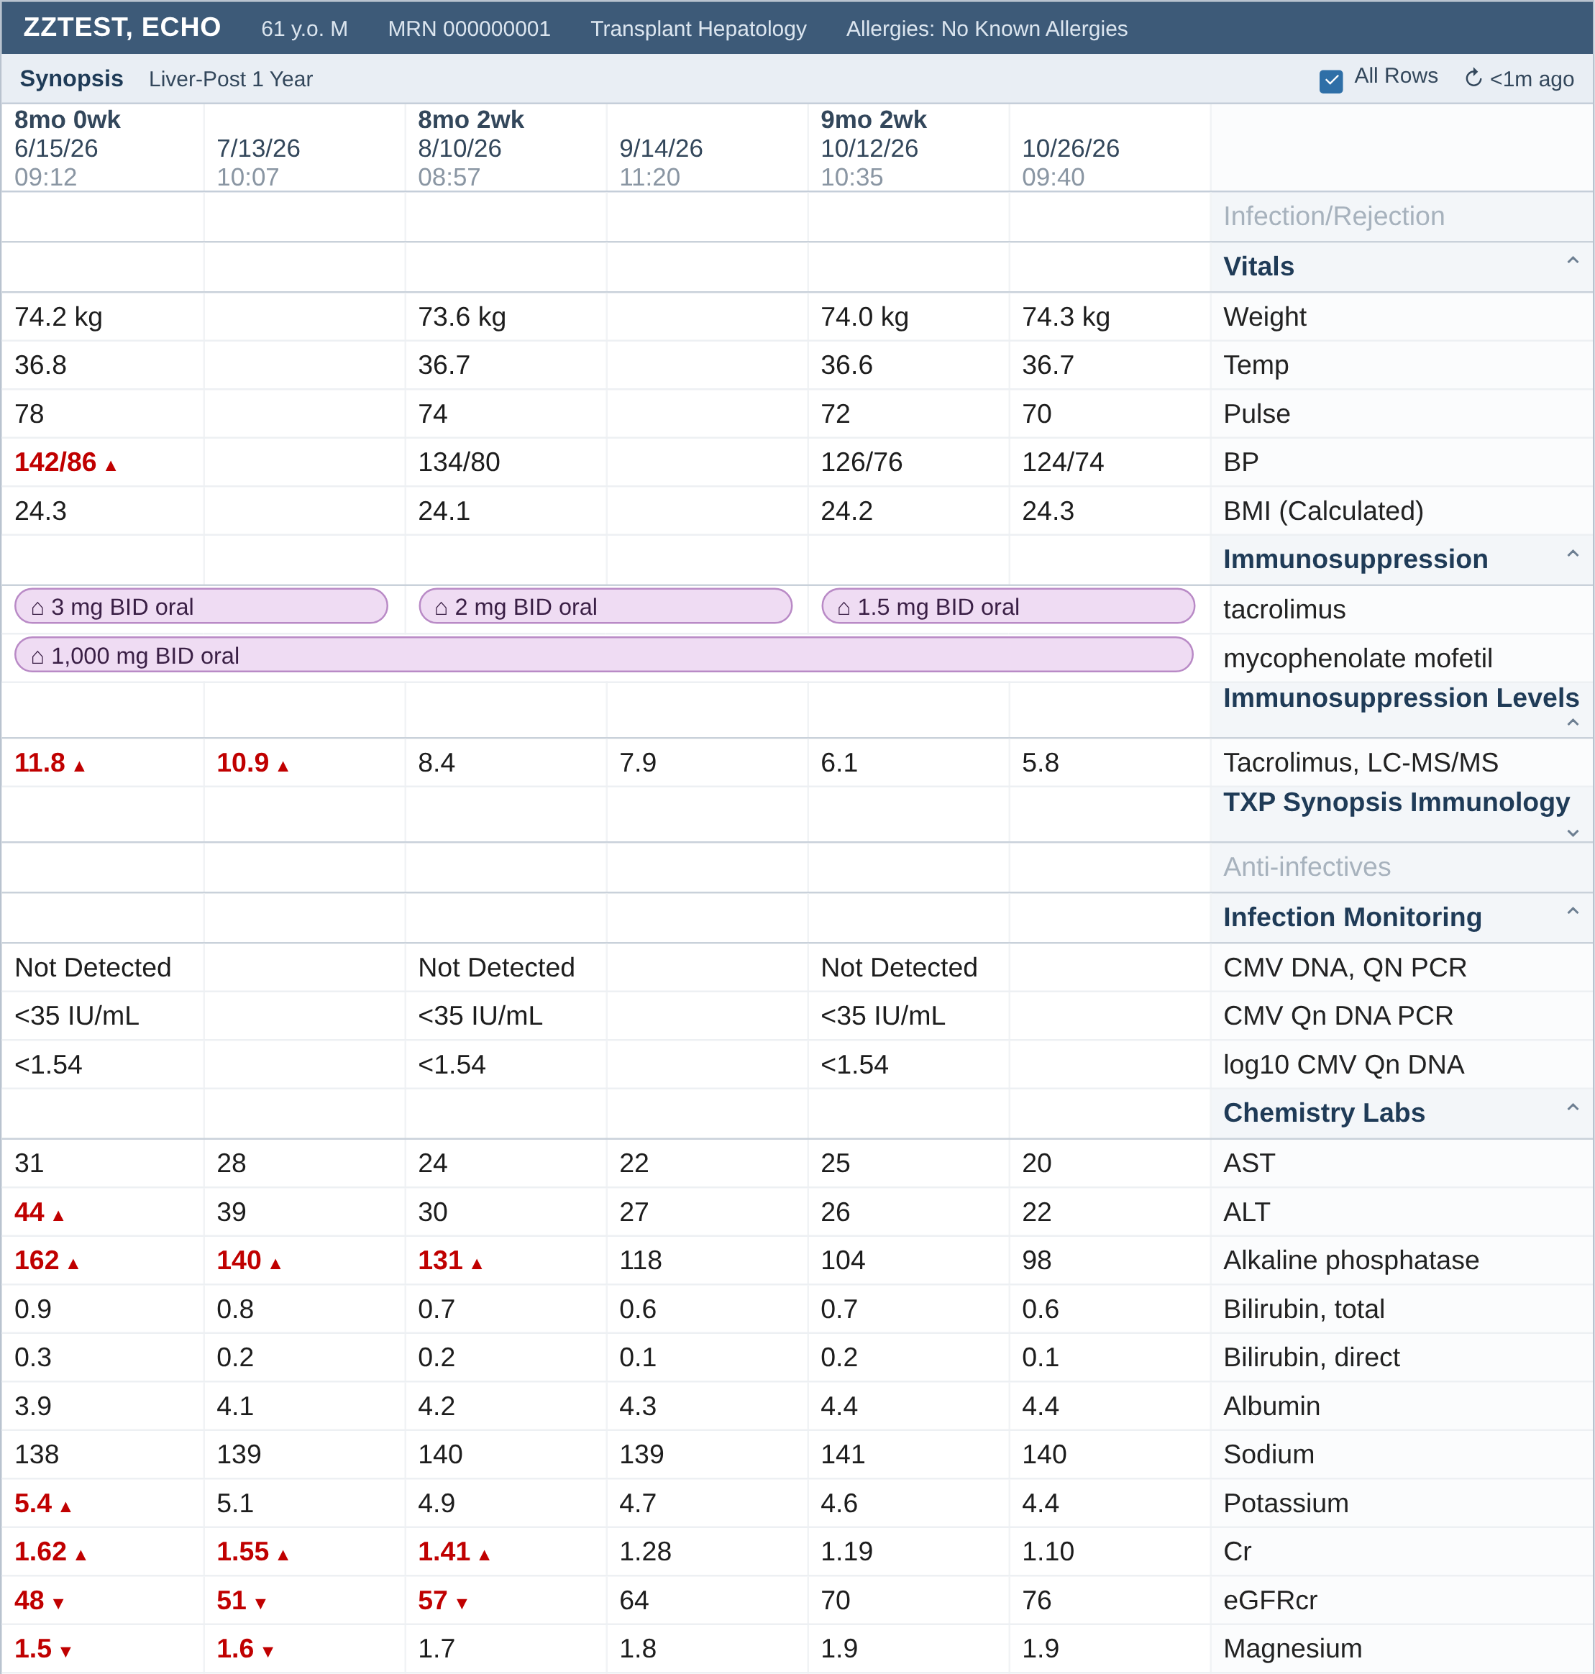
We built three Synopsis views. You can too
Finding information
Liver disease
CLD workup
After transplant
Start from one of Epic's Synopsis views, then sit with your Epic analyst and add the sections you look for every day
Mock-up with invented data, not a real patient or a real screen. Epic Synopsis Setup and Support Guide, 2026
7/26
Notes:
We built three views at our center: a liver disease view for cirrhosis over time, one for the chronic liver disease workup that shows the most recent value of every etiology test in the last 20 years, and one for after transplant. Epic ships a cirrhosis view, built with its Hepatology Specialty Steering Board, that your analyst can import; we started there and kept adding sections. You can do the same: it's a build request, not a product purchase.

Slide 12
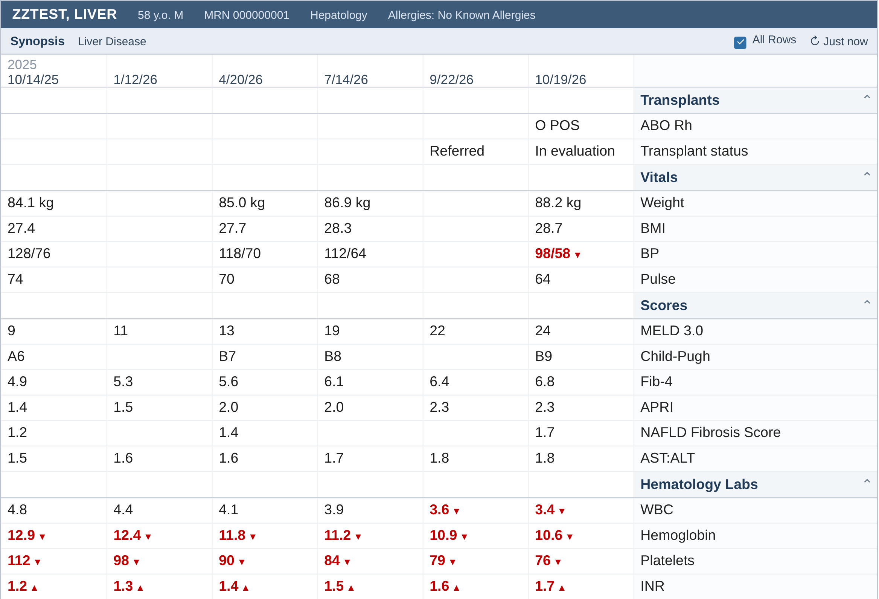
Our liver disease view
Finding information
Scrolling, 1 of 3
Mock-up with invented data, not a real patient or a real screen. Built from our transplant center's views
8/26
Notes:
One screen, scrolled; the date row stays at the top. Click through quickly. Sections, top to bottom: transplant status, vitals, scores (MELD 3.0, Child-Pugh, Fib-4, APRI, NAFLD fibrosis, AST:ALT), hematology, chemistry, other labs, ascitic fluid, blood products, micro, anti-infectives, liver meds, other meds, imaging, cardiac testing, procedures, urine and stool output, dialysis, toxicology (PEth, drug screen). Meds are bars over time so you see when a dose changed.

Slide 13
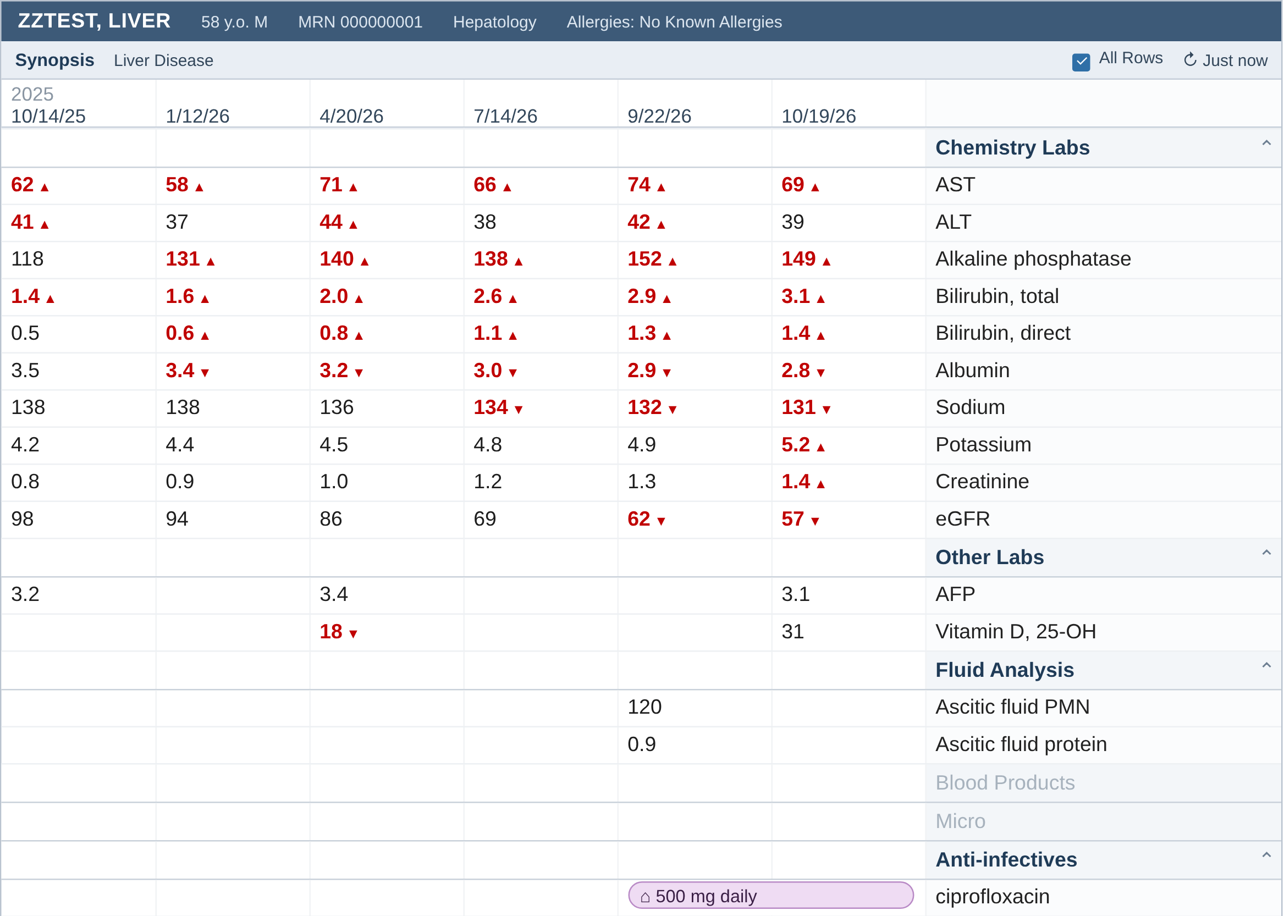
Our liver disease view
Finding information
Scrolling, 2 of 3
Mock-up with invented data, not a real patient or a real screen. Built from our transplant center's views
8/26
Notes:
One screen, scrolled; the date row stays at the top. Click through quickly. Sections, top to bottom: transplant status, vitals, scores (MELD 3.0, Child-Pugh, Fib-4, APRI, NAFLD fibrosis, AST:ALT), hematology, chemistry, other labs, ascitic fluid, blood products, micro, anti-infectives, liver meds, other meds, imaging, cardiac testing, procedures, urine and stool output, dialysis, toxicology (PEth, drug screen). Meds are bars over time so you see when a dose changed.

Slide 14
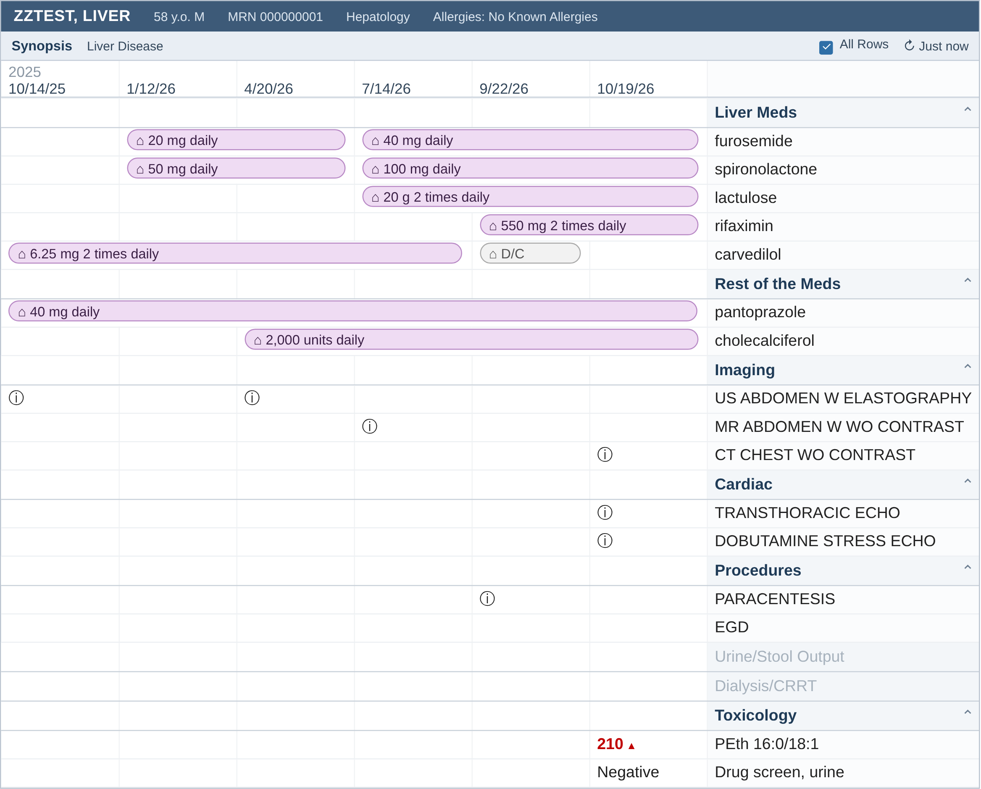
Our liver disease view
Finding information
Scrolling, 3 of 3
Mock-up with invented data, not a real patient or a real screen. Built from our transplant center's views
8/26
Notes:
One screen, scrolled; the date row stays at the top. Click through quickly. Sections, top to bottom: transplant status, vitals, scores (MELD 3.0, Child-Pugh, Fib-4, APRI, NAFLD fibrosis, AST:ALT), hematology, chemistry, other labs, ascitic fluid, blood products, micro, anti-infectives, liver meds, other meds, imaging, cardiac testing, procedures, urine and stool output, dialysis, toxicology (PEth, drug screen). Meds are bars over time so you see when a dose changed.

Slide 15
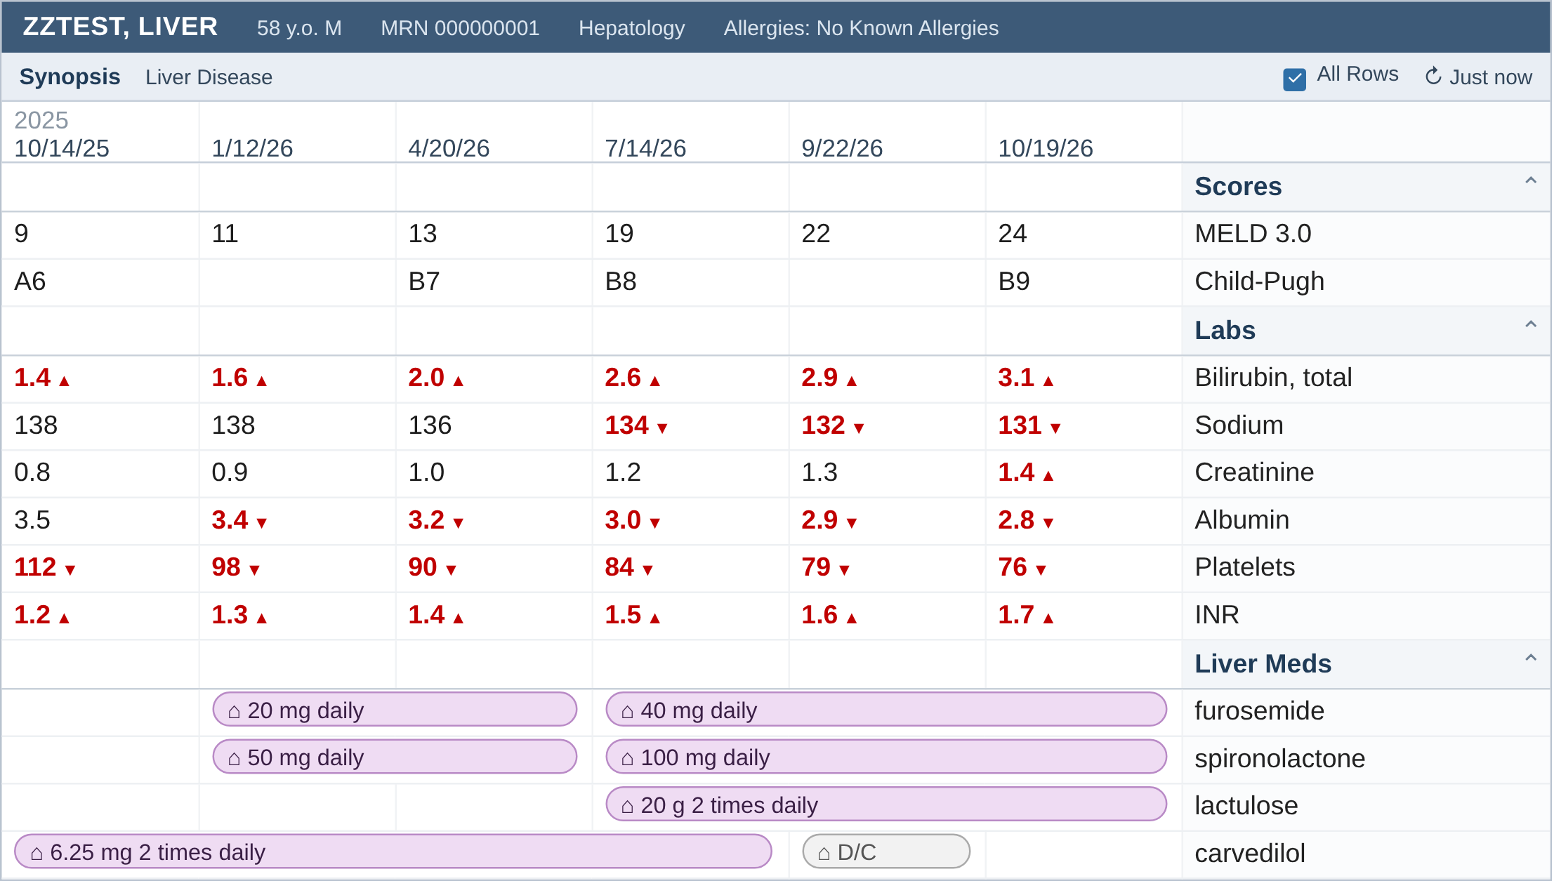
Our liver disease view
Finding information
Where is his MELD going?
Mock-up with invented data, not a real patient or a real screen
9/26
Notes:
Same view, the rows that matter for this visit. Ask the room where the MELD is going, then show the row. Also point at the diuretics going up and carvedilol stopped when the pressure dropped. With Phoenix the view can also show the MELD last reported to UNOS.

Slide 16
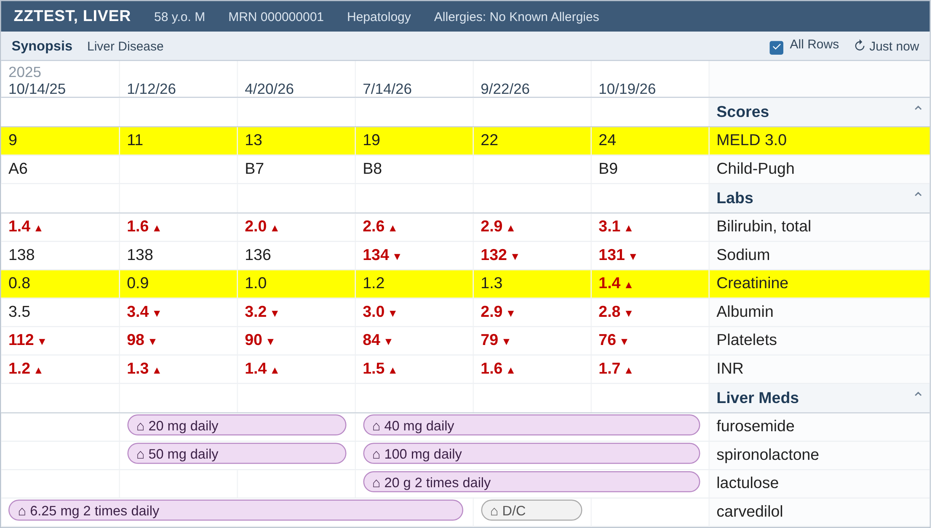
Our liver disease view
Finding information
MELD 3.0 went from 9 to 24 in a year, with the creatinine rising
Mock-up with invented data, not a real patient or a real screen
9/26
Notes:
Same view, the rows that matter for this visit. Ask the room where the MELD is going, then show the row. Also point at the diuretics going up and carvedilol stopped when the pressure dropped. With Phoenix the view can also show the MELD last reported to UNOS.

Slide 17
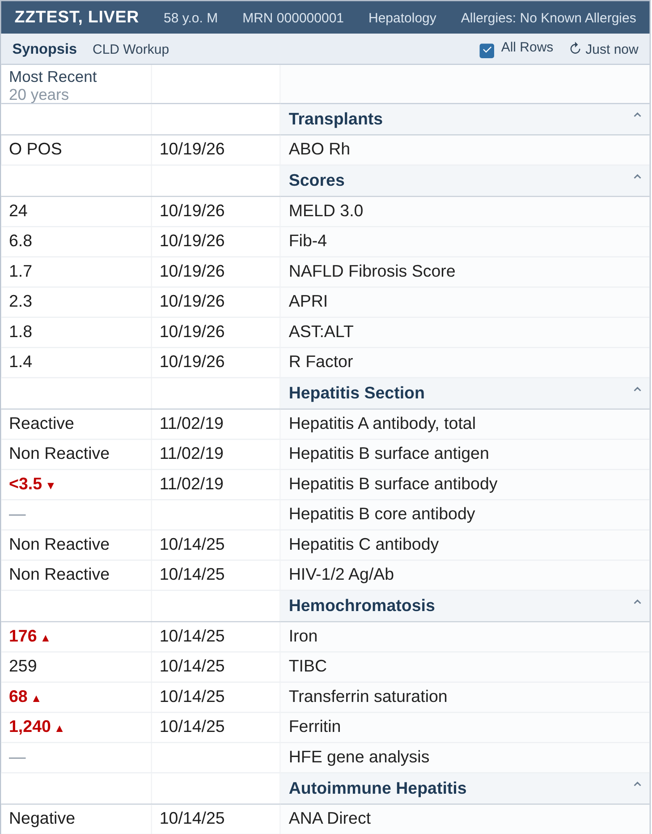
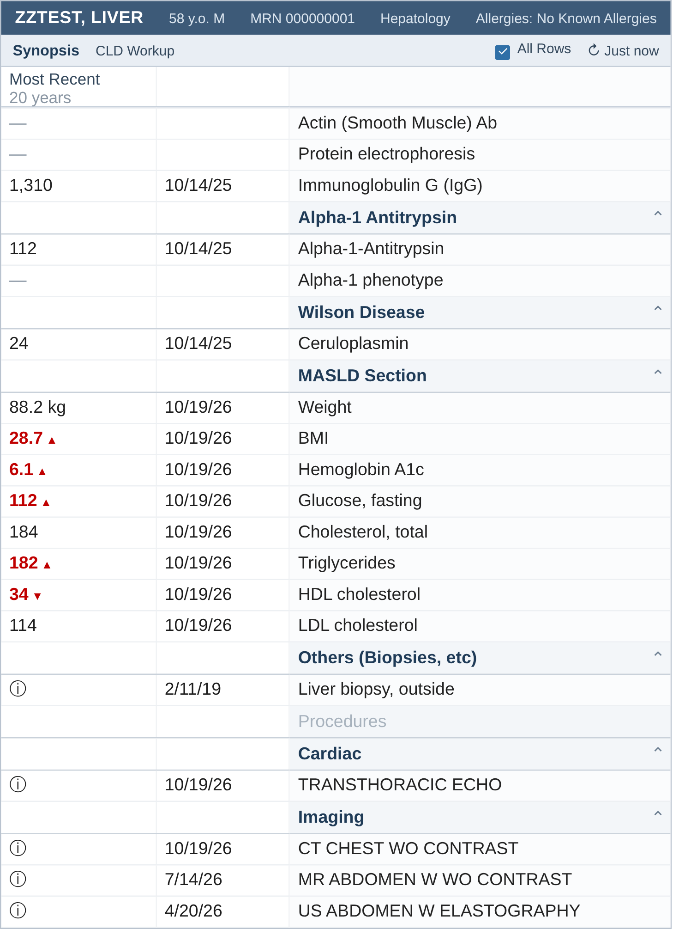
Our chronic liver disease workup view
Finding information
Was the workup done?
Mock-up with invented data, not a real patient or a real screen
10/26
Notes:
The most recent value of each test in the last 20 years, with its date; a dash means never done. Sections: transplant (ABO), scores, hepatitis, hemochromatosis, autoimmune, alpha-1, Wilson, MASLD (weight, BMI, A1c, fasting glucose, lipids), biopsies, cardiac and imaging. Ask: was the workup done? Gaps: HBV core antibody and HFE never sent, HBsAb negative so he needs the vaccine, and the MASLD section shows A1c 6.1, high triglycerides and low HDL. This took a minute instead of digging through 14 years of results.

Slide 18
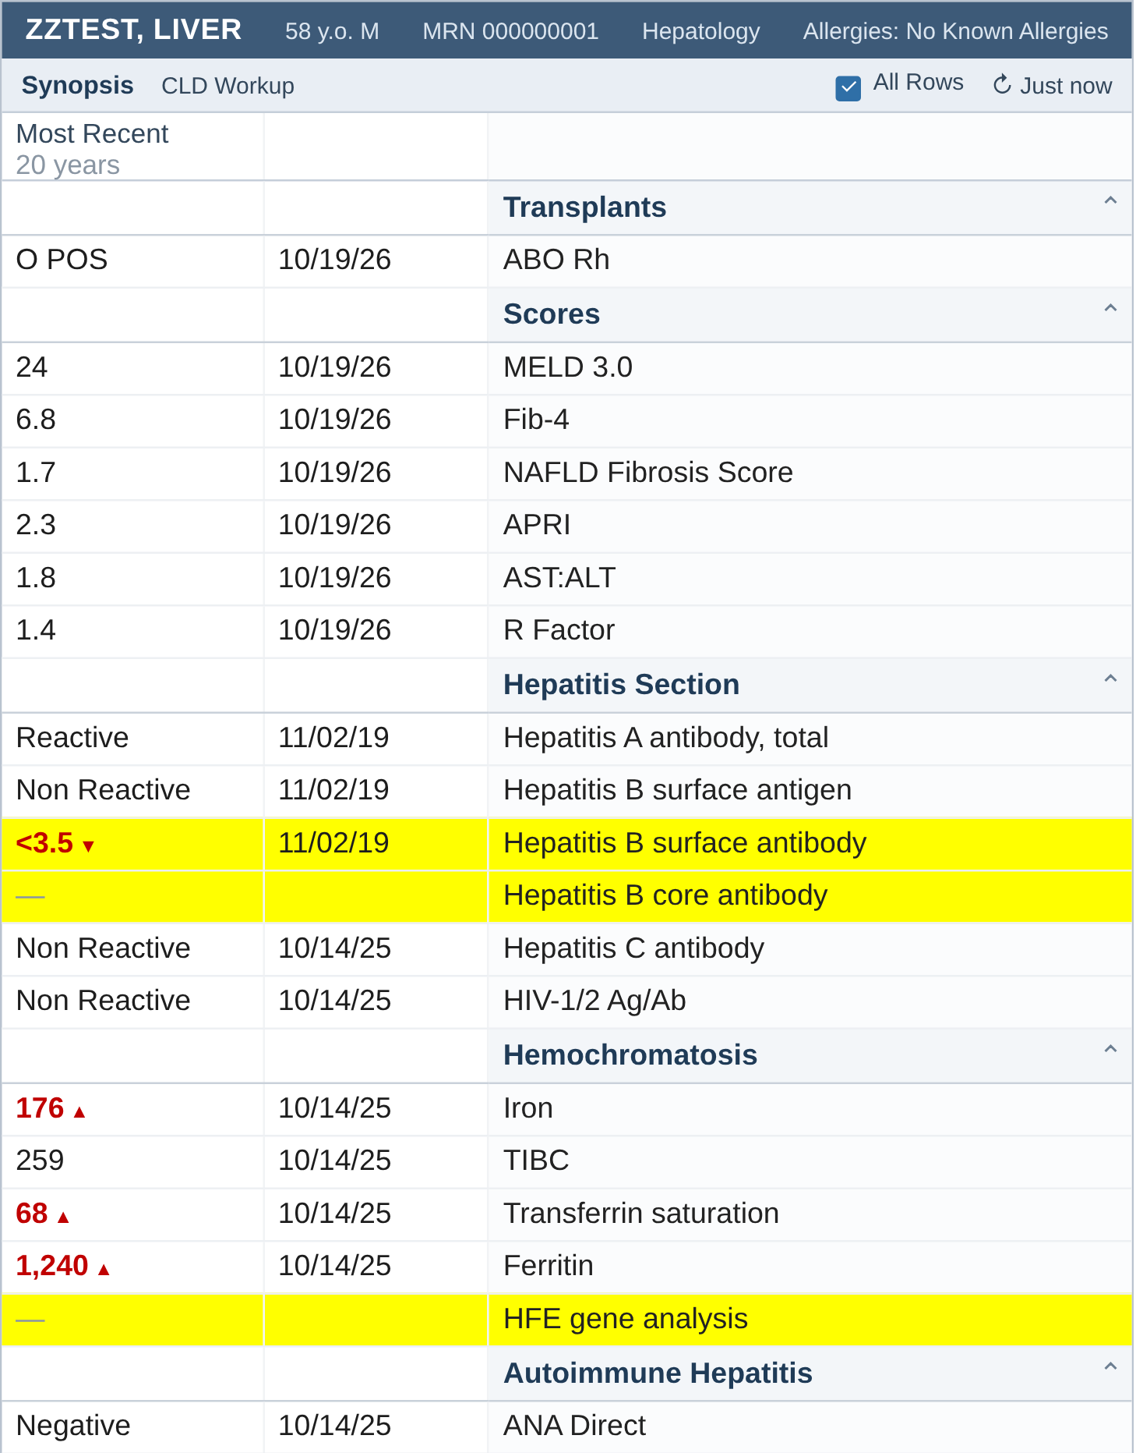
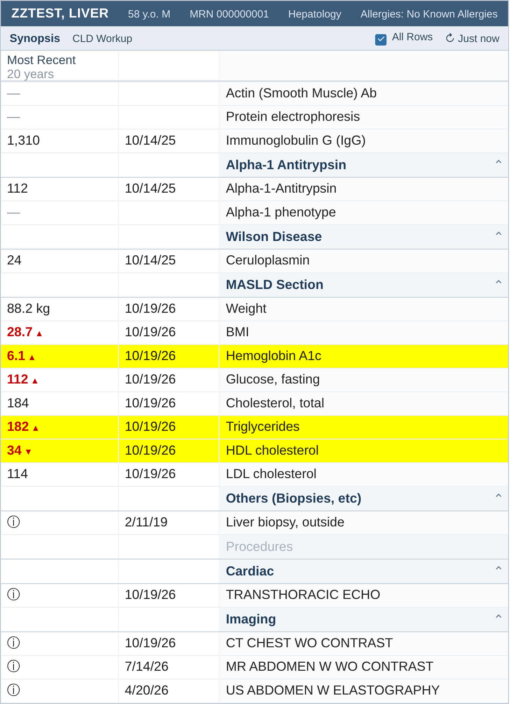
Our chronic liver disease workup view
Finding information
No HBV core antibody or HFE, HBsAb negative, and metabolic risk
Mock-up with invented data, not a real patient or a real screen
10/26
Notes:
The most recent value of each test in the last 20 years, with its date; a dash means never done. Sections: transplant (ABO), scores, hepatitis, hemochromatosis, autoimmune, alpha-1, Wilson, MASLD (weight, BMI, A1c, fasting glucose, lipids), biopsies, cardiac and imaging. Ask: was the workup done? Gaps: HBV core antibody and HFE never sent, HBsAb negative so he needs the vaccine, and the MASLD section shows A1c 6.1, high triglycerides and low HDL. This took a minute instead of digging through 14 years of results.

Slide 19
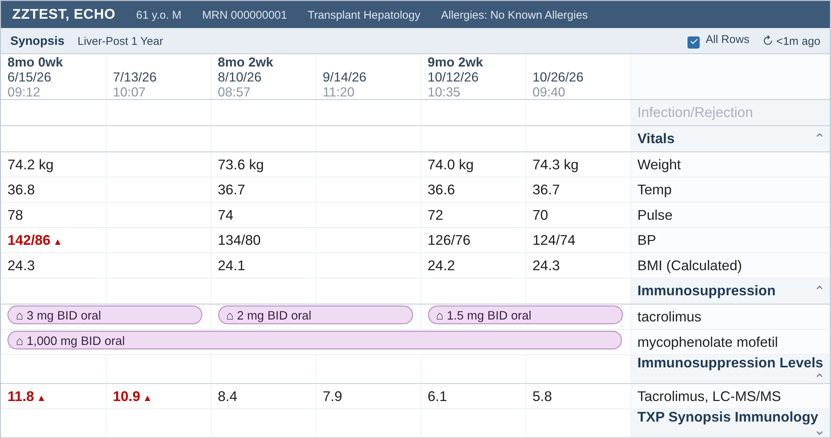
Our post-transplant view
Finding information
Scrolling, 1 of 3
Mock-up with invented data, not a real patient or a real screen. Built from our transplant center's views
11/26
Notes:
A different made-up patient, 9 months after transplant. Same order as our real view: vitals, then immunosuppression with the tacrolimus levels right under the doses, transplant immunology, anti-infectives, infection monitoring (CMV), then chemistry with PEth, hematology, toxicology and the rest of the meds. Our post-transplant clinic opens this first: dose changes line up with the levels and the creatinine.

Slide 20
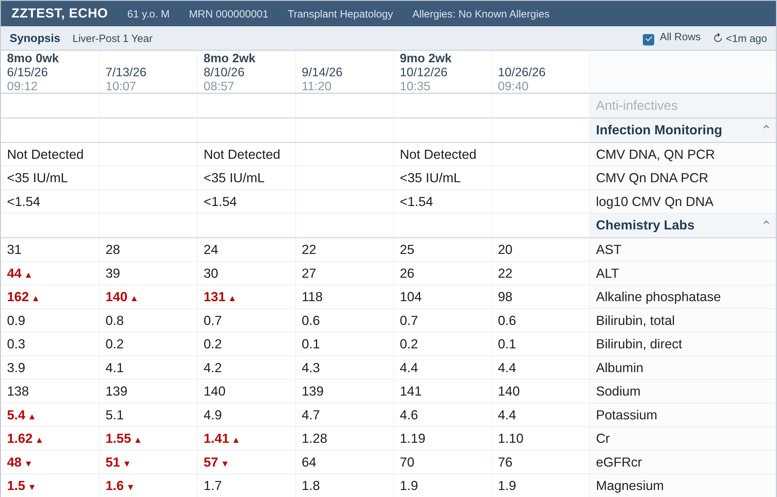
Our post-transplant view
Finding information
Scrolling, 2 of 3
Mock-up with invented data, not a real patient or a real screen. Built from our transplant center's views
11/26
Notes:
A different made-up patient, 9 months after transplant. Same order as our real view: vitals, then immunosuppression with the tacrolimus levels right under the doses, transplant immunology, anti-infectives, infection monitoring (CMV), then chemistry with PEth, hematology, toxicology and the rest of the meds. Our post-transplant clinic opens this first: dose changes line up with the levels and the creatinine.

Slide 21
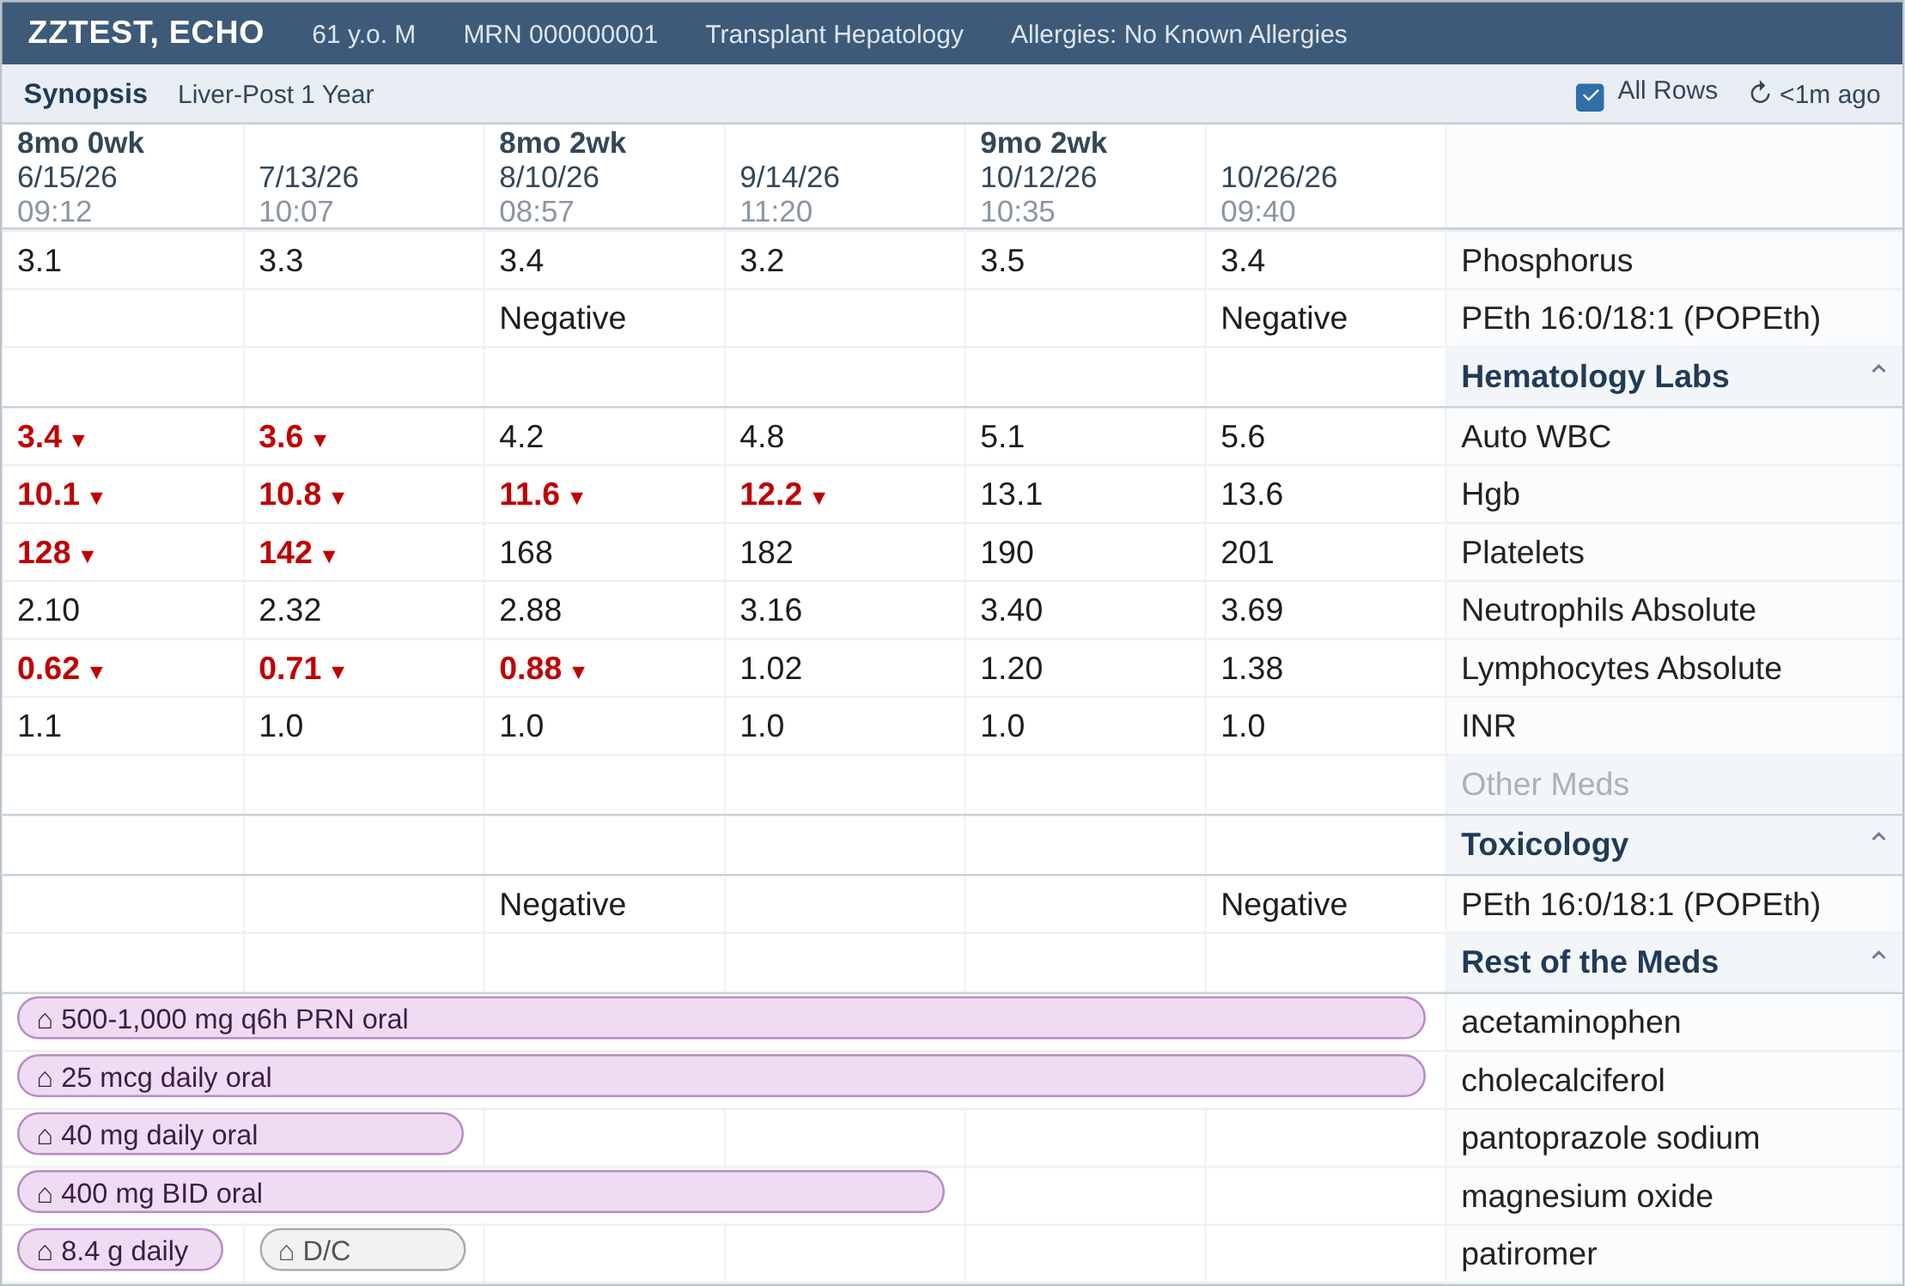
Our post-transplant view
Finding information
Scrolling, 3 of 3
Mock-up with invented data, not a real patient or a real screen. Built from our transplant center's views
11/26
Notes:
A different made-up patient, 9 months after transplant. Same order as our real view: vitals, then immunosuppression with the tacrolimus levels right under the doses, transplant immunology, anti-infectives, infection monitoring (CMV), then chemistry with PEth, hematology, toxicology and the rest of the meds. Our post-transplant clinic opens this first: dose changes line up with the levels and the creatinine.

Slide 22
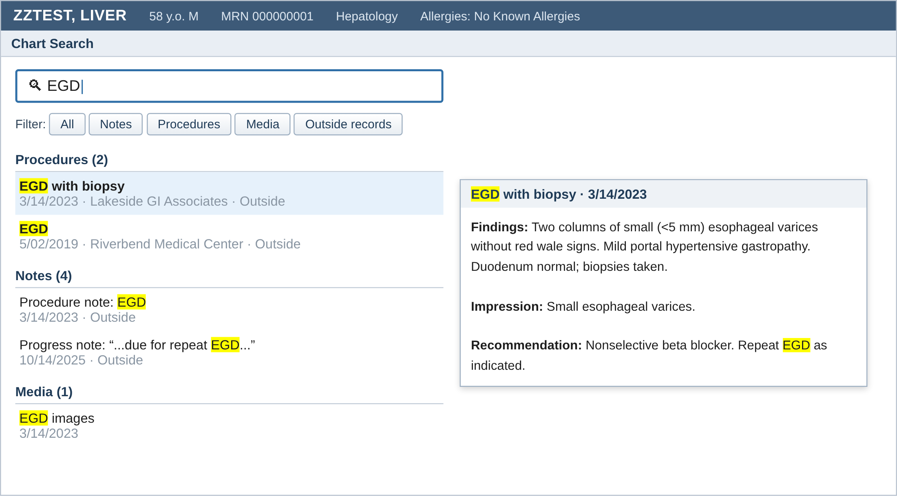
Chart search
Finding information
Searches notes, results, media and outside records. Hover to read. Save the searches you repeat.
Mock-up with invented data, not a real patient or a real screen. Epic chart search tip sheet, 2026
12/26
Notes:
Last EGD: type EGD. The 2023 outside EGD shows up and the hover preview gives small varices without opening anything. Favorite searches I keep: EGD, MRI, biopsy, PEth. You can also type Synopsis or an order set name in the same bar to jump straight there.

Slide 23
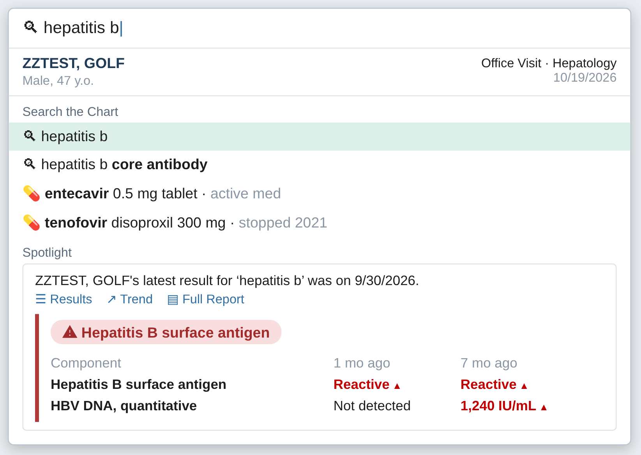
Chart search does more
Finding information
Type hepatitis b: it also offers entecavir and tenofovir
Mock-up with invented data, not a real patient or a real screen. Epic Specialist Spotlight: Search Tips for Hepatologists, November 2025; Epic Assistant Bar and Chart Search Setup and Support Guide, 2026
12/26
Notes:
Related terms. I type hepatitis b and it suggests the core and surface antibodies and also his entecavir and tenofovir. The spotlight card shows the latest result without opening anything. Results show up before you press Enter; press Enter for the full list. Quotation marks give the exact word only, and AND / OR work too.

Slide 24
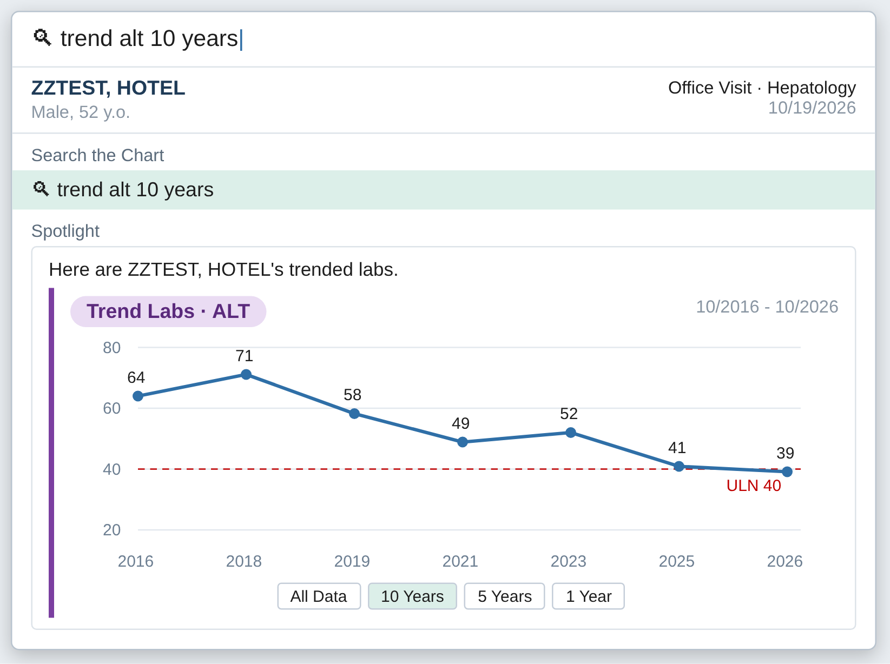
Chart search does more
Finding information
Type trend alt 10 years: the graph opens in the search box
Mock-up with invented data, not a real patient or a real screen. Epic Specialist Spotlight: Search Tips for Hepatologists, November 2025; Epic Assistant Bar and Chart Search Setup and Support Guide, 2026
12/26
Notes:
Trends. Steatotic liver disease follow-up: type trend alt 10 years and the graph is right there. You can switch to 5 years or 1 year, and trend two labs together, like ALT and AST. Was it ever elevated? Yes, up to 71 in 2018, and normal now after weight loss. Works for labs and vitals, weight included.

Slide 25
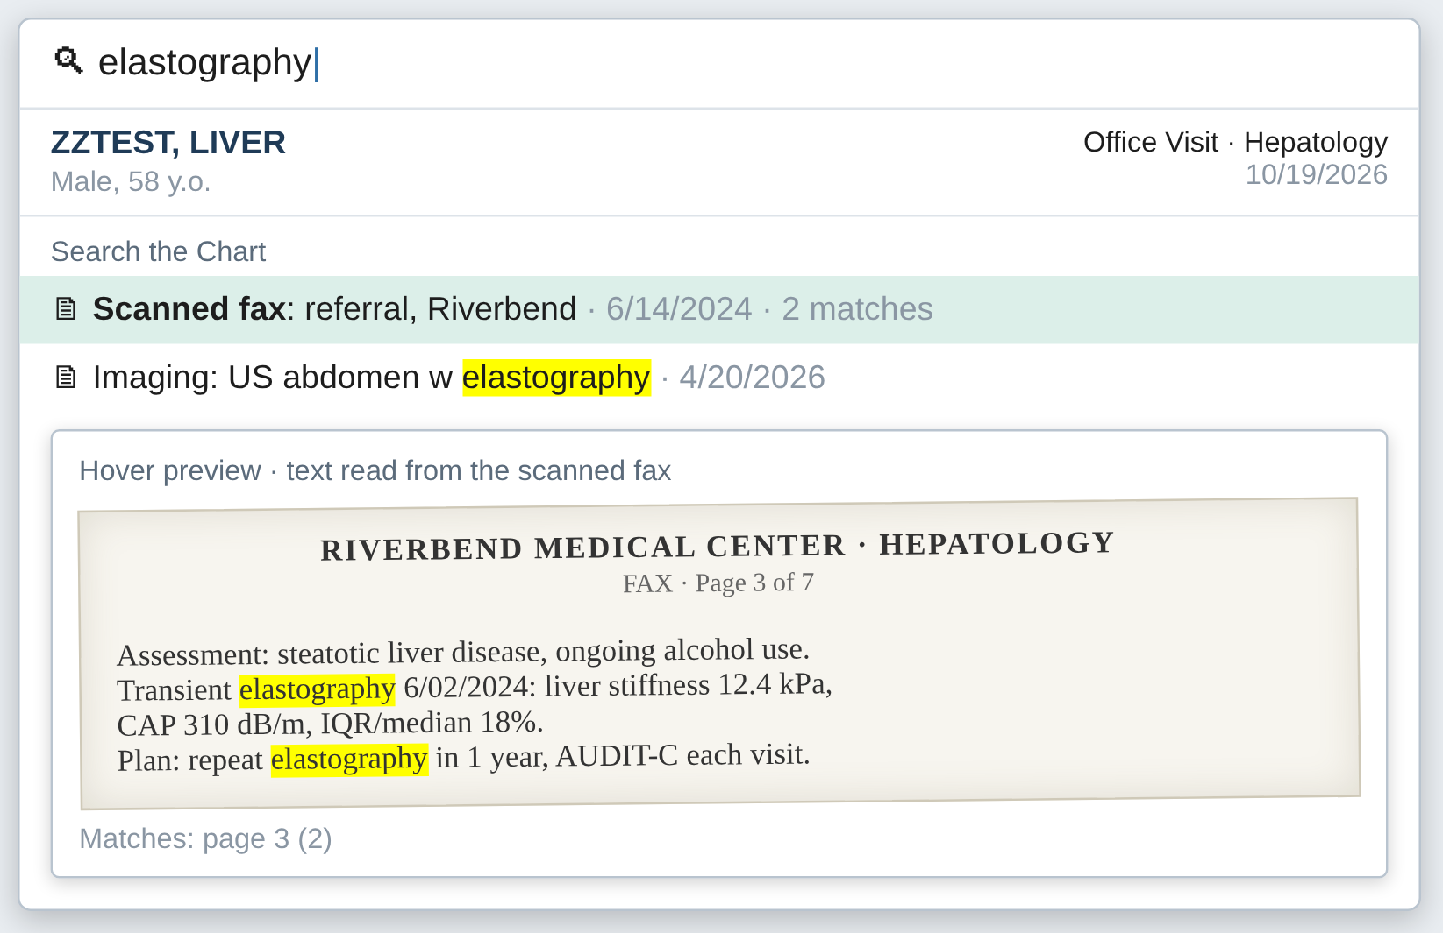
Chart search does more
Finding information
Scanned faxes are searchable too: it reads the text (OCR)
Mock-up with invented data, not a real patient or a real screen. Epic Specialist Spotlight: Search Tips for Hepatologists, November 2025; Epic Assistant Bar and Chart Search Setup and Support Guide, 2026
12/26
Notes:
Scanned documents. Chart search reads the text of scanned documents with OCR, so the outside referral fax is searchable. Hover and you see the page with the words highlighted: his 2024 FibroScan, 12.4 kPa, was only in a fax. Your organization has to turn this on, and it reads documents scanned in the last two years when it starts, so ask your Epic team if yours is on.

Slide 26
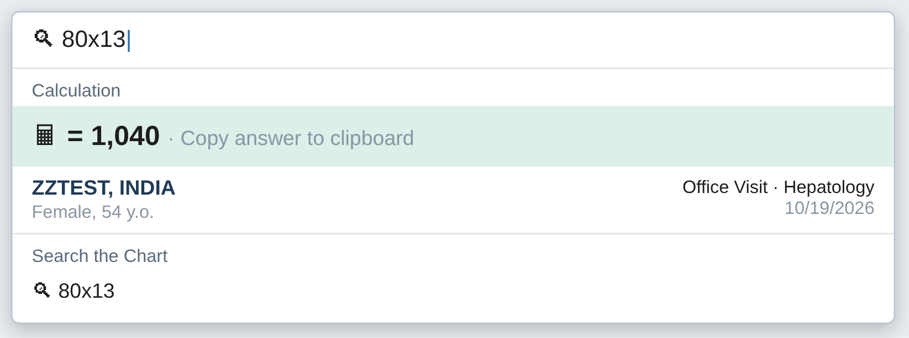
Chart search does more
Finding information
Ursodiol for PBC: 80 kg x 13 mg/kg, typed straight in
Mock-up with invented data, not a real patient or a real screen. Epic Specialist Spotlight: Search Tips for Hepatologists, November 2025; Epic Assistant Bar and Chart Search Setup and Support Guide, 2026
12/26
Notes:
Math. Ursodiol for PBC at 13 to 15 mg/kg. I type 80x13 and get 1,040 mg, with a button to copy the answer. No calculator. It does unit conversions too, like pounds to kilograms.

Slide 27
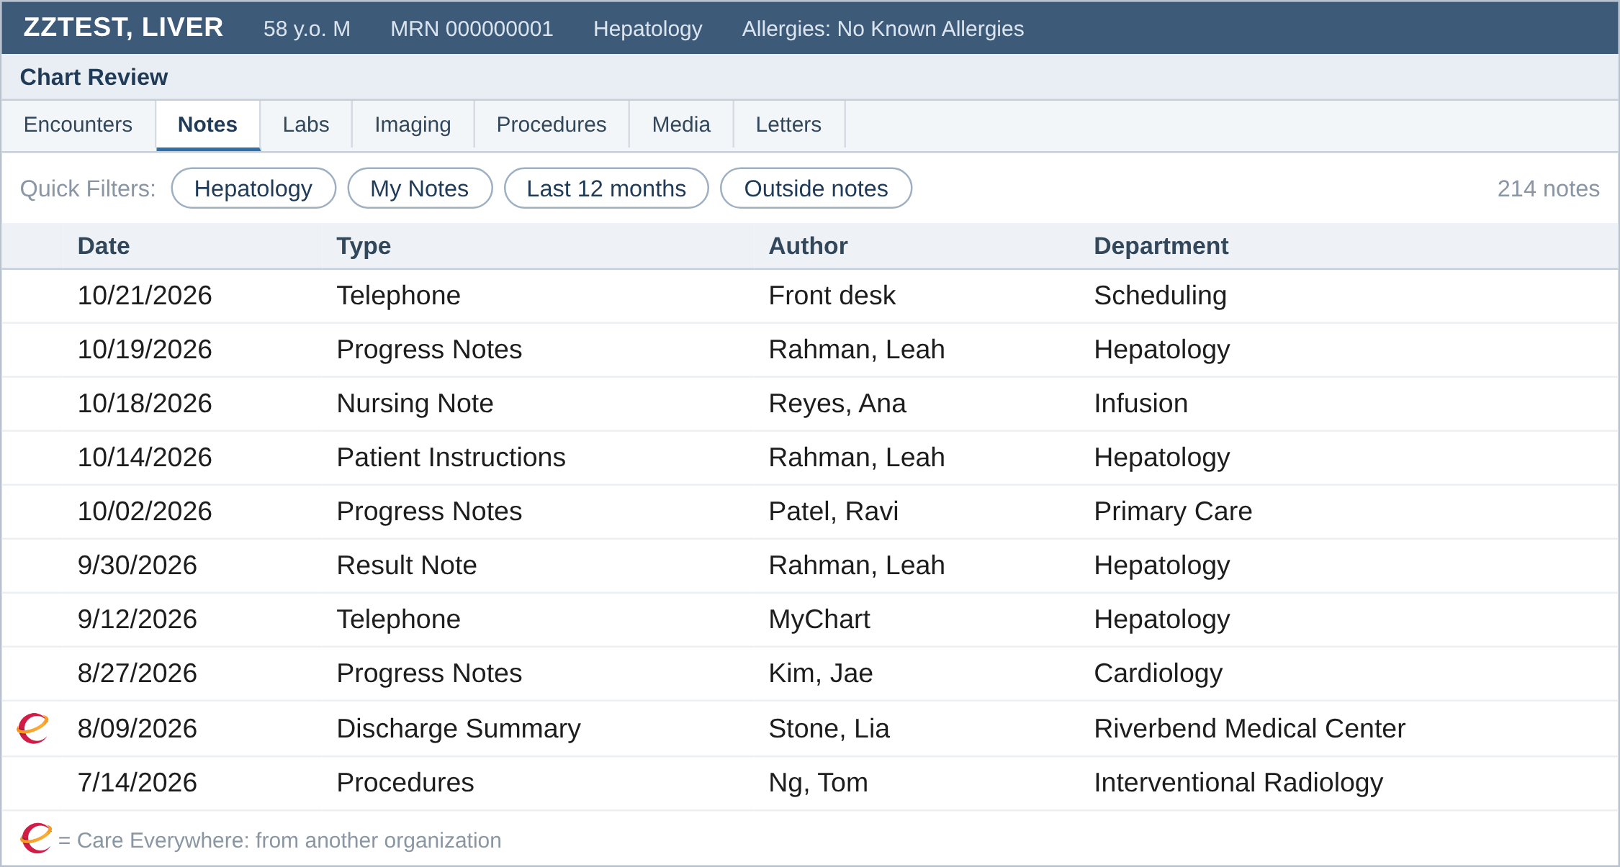
Chart Review quick filters
Finding information
Notes tab, no filter: 214 notes
Mock-up with invented data, not a real patient or a real screen. Epic Chart Review Setup and Support Guide, 2026
13/26
Notes:
Chart Review, Notes tab, no filter: 214 notes, phone calls, nursing, other clinics. Scrolling this before every visit is where the time goes. The buttons above the list are quick filters.

Slide 28
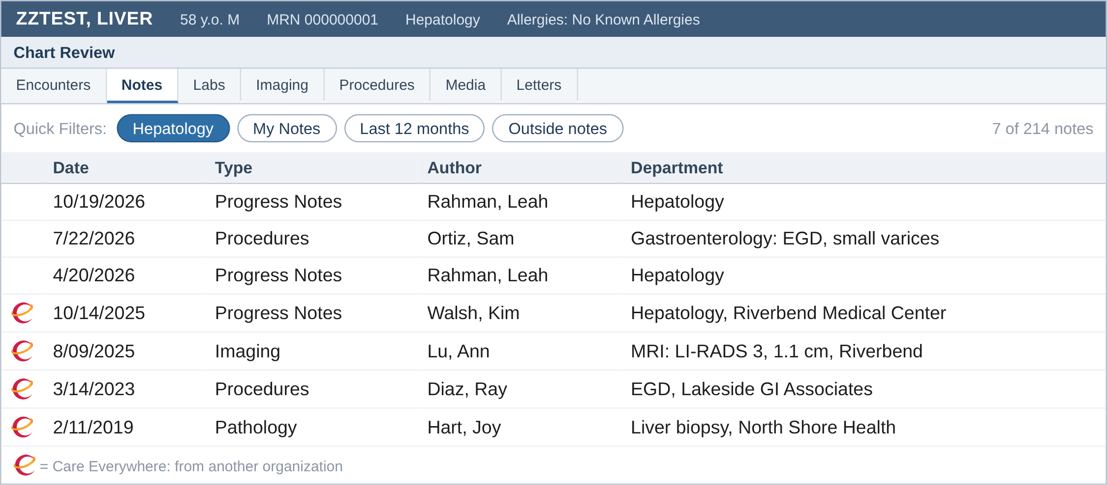
Chart Review quick filters
Finding information
One click on our Hepatology quick filter: 7 notes, outside ones included
Mock-up with invented data, not a real patient or a real screen. Epic Chart Review Setup and Support Guide, 2026
13/26
Notes:
Same list with our Hepatology quick filter on: hepatology notes, GI procedures, imaging and pathology. The green CE icon marks notes from other organizations through Care Everywhere, so his outside MRI with the LI-RADS 3 observation and the 2019 biopsy sit in the same list. You can build your own quick filter from Chart Review in a minute, or ask your analyst to make one for the whole division.

Slide 29
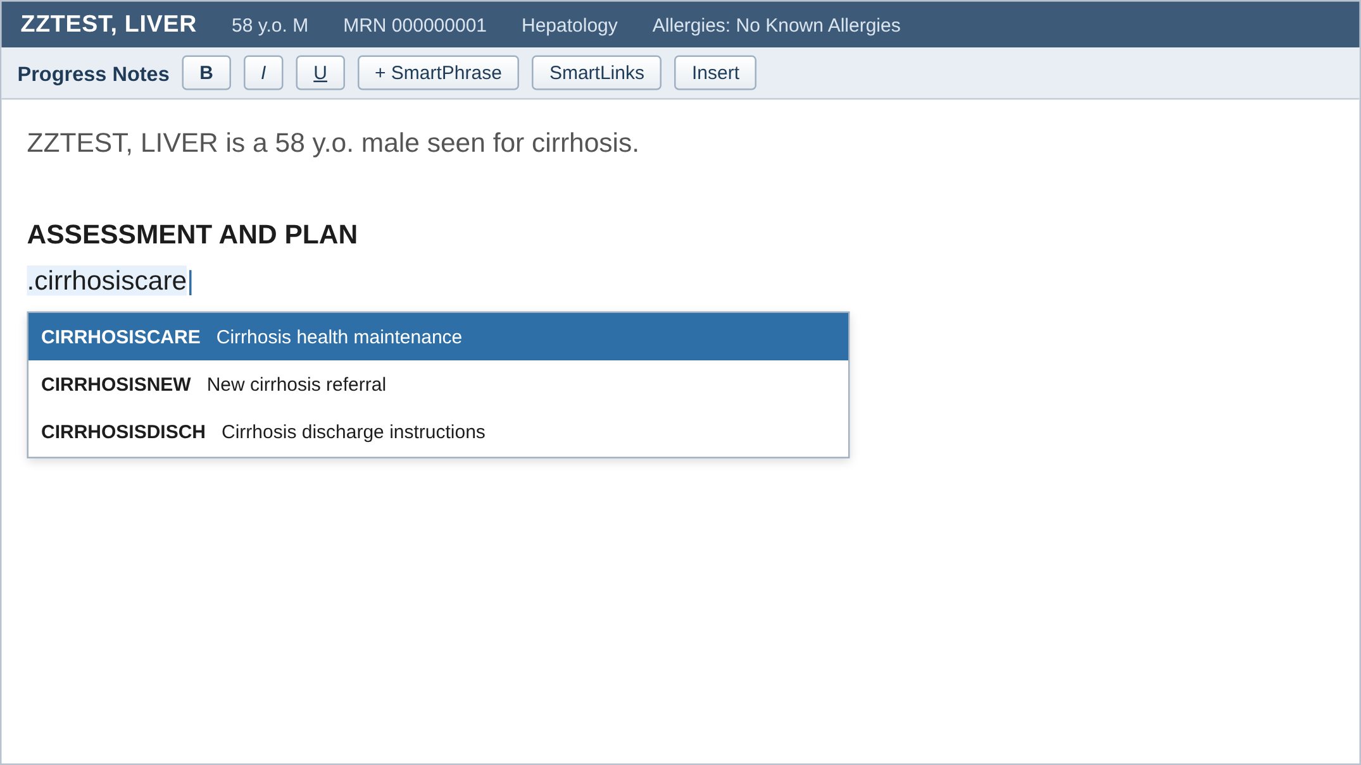
SmartPhrases
Notes and orders
Mock-up with invented data, not a real patient or a real screen. Epic SmartTools Setup and Support Guide, 2026; Epic, How to Personalize Epic
14/26
Notes:
Type the dot phrase, pick it, and the plan writes itself with today's MELD, last imaging and last EGD pulled in. I won't spend long on notes: Nizar covered the AI side. Trap: copy-forward carries old numbers, SmartLinks don't. Ask a colleague to share theirs from the SmartPhrase Manager; you don't have to build from scratch. Since February 2026 you can preview a SmartPhrase against a real chart before using it.

Slide 30
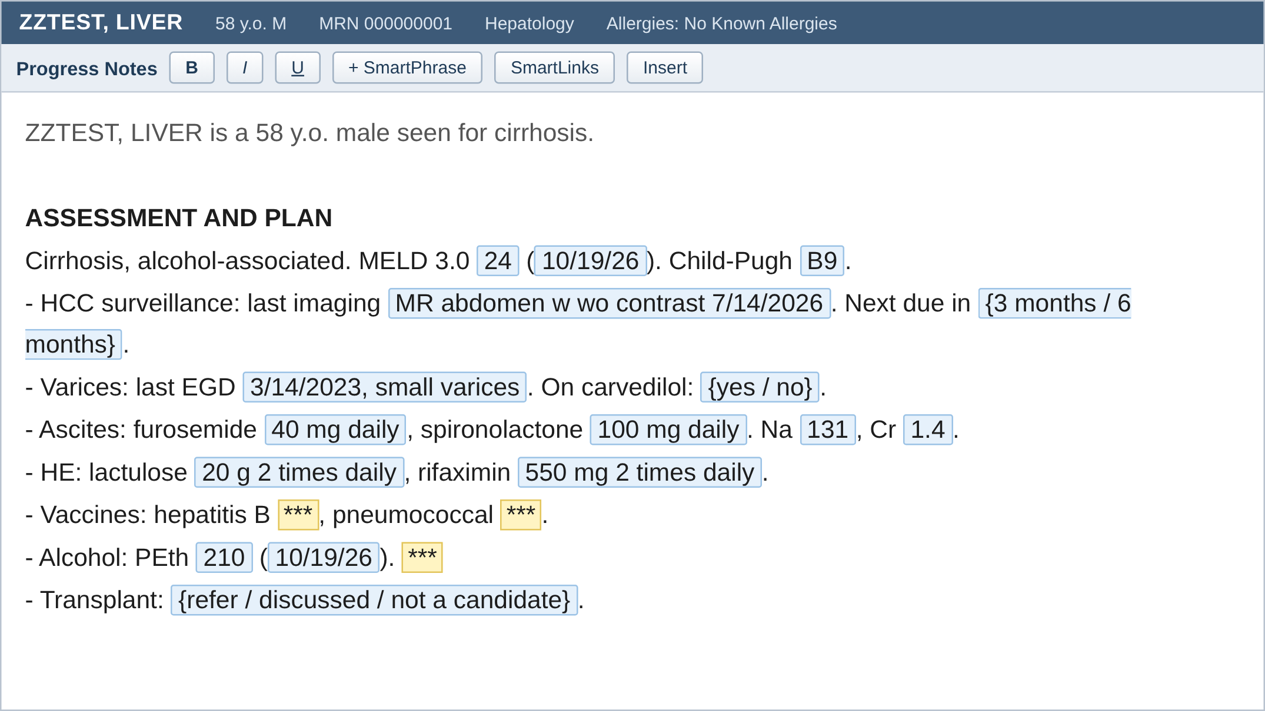
SmartPhrases
Notes and orders
Blue fields are pulled from the chart
{ } lists are one click
*** has to be filled before you sign
Share yours with colleagues, or use theirs
Mock-up with invented data, not a real patient or a real screen. Epic SmartTools Setup and Support Guide, 2026; Epic, How to Personalize Epic
14/26
Notes:
Type the dot phrase, pick it, and the plan writes itself with today's MELD, last imaging and last EGD pulled in. I won't spend long on notes: Nizar covered the AI side. Trap: copy-forward carries old numbers, SmartLinks don't. Ask a colleague to share theirs from the SmartPhrase Manager; you don't have to build from scratch. Since February 2026 you can preview a SmartPhrase against a real chart before using it.

Slide 31
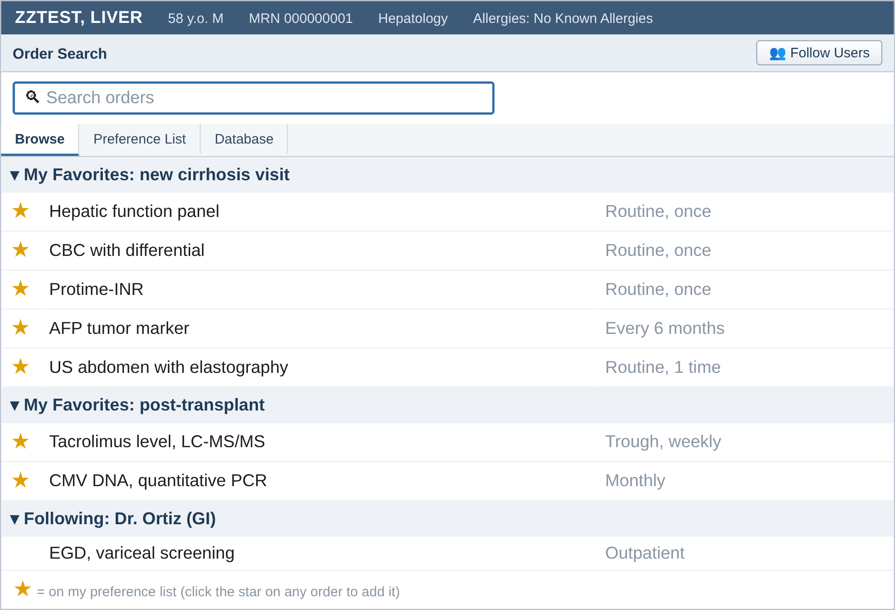
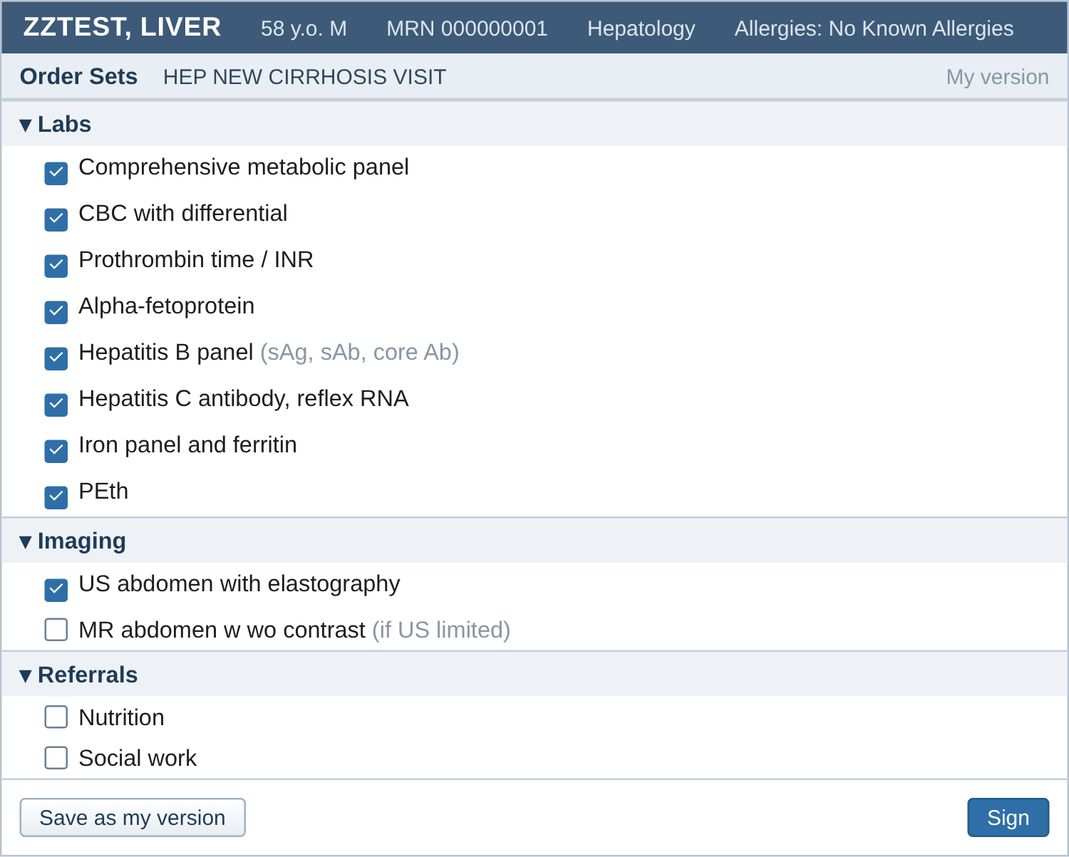
Orders
Notes and orders
Star an order to put it on your preference list. Follow up to 3 colleagues' lists.
Save your own version of an order set
Mock-up with invented data, not a real patient or a real screen. Epic Preference Lists Setup and Support Guide, 2026; Epic, How to Personalize Epic
15/26
Notes:
Preference list: click the star on any order, or right-click it, and it goes into your own list in the section you pick. Follow Users on the Browse tab lets you use a colleague's lists, up to three people, so one person in the division builds it and everyone follows. Every new cirrhosis visit gets the same labs and ultrasound: save it once as your version of the order set. Safety point: check the encounter before signing; inpatient orders placed under a clinic visit don't reach the floor.

Slide 32
After March 2020
In Basket
Which group's EHR time grew most after March 2020?
Holmgren AJ et al. JAMA Intern Med 2025;185:461-3. Epic Signal data, 280,712 physicians, 2019 to 2022 [PMID: 39992635]
16/26
Notes:
Hepatology sits with the medical subspecialists: EHR time up about 10%. Primary care went from 10.6 to 11.3 hours a week. The messages did not replace phone calls; the calls came back and the messages stayed. Limits: one vendor, no burnout measure.

Slide 33
After March 2020
In Basket
Which group's EHR time grew most after March 2020?
Patient messages jumped in March 2020 and stayed high. Phone calls went back to baseline.
Holmgren AJ et al. JAMA Intern Med 2025;185:461-3. Epic Signal data, 280,712 physicians, 2019 to 2022 [PMID: 39992635]
16/26
Notes:
Hepatology sits with the medical subspecialists: EHR time up about 10%. Primary care went from 10.6 to 11.3 hours a week. The messages did not replace phone calls; the calls came back and the messages stayed. Limits: one vendor, no burnout measure.

Slide 34
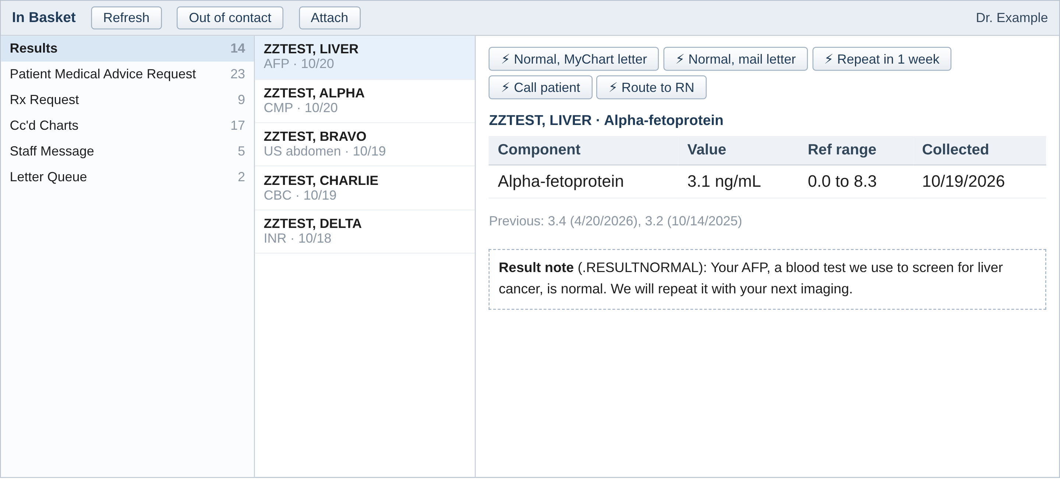
In Basket tools
In Basket
QuickActions for normal results, result notes from a SmartPhrase, out of contact when you're away
Mock-up with invented data, not a real patient or a real screen. Epic In Basket Guide for Providers
17/26
Notes:
A normal AFP: one click sends the MyChart letter, done. Build three or four QuickActions for the results you see every day. Result notes come from a SmartPhrase so the wording is the same each time. Set out of contact and a delegate before vacation, not after.

Slide 35
AI tools in Epic
AI in the chart
Tool | What it does | Epic version
In Basket drafts | Drafts a reply to a patient message | Nov 2023
Insights | Summarizes recent notes before a visit | Feb 2025
Synopsis Insights | Shows why a medication was changed | Aug 2025
Chart with Art | Drafts the note from the visit conversation | May 2026
Ask Art | Answers questions about the chart | May 2026
Chart with Art for orders | Queues orders from the conversation | Aug 2026
What you have depends on your organization's version and what it turned on
Epic Generative AI Feature Library, 2026. Art is Epic's AI for clinicians
18/26
Notes:
These are the ones a hepatologist will touch. Version is the Epic release where it became generally available; your system may be a release or two behind, and some need to be requested from Epic. Ask your informatics team which ones are on. Every suggestion still needs your review and signature.

Slide 36
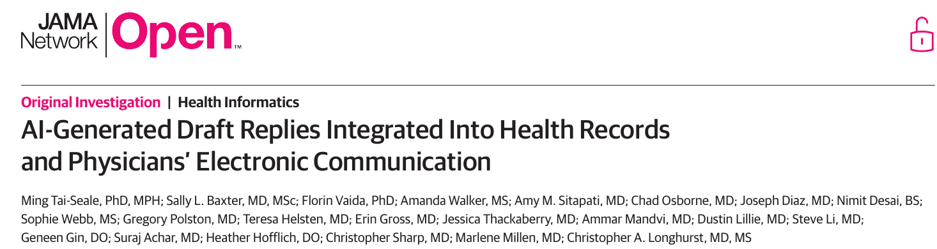
Do AI drafts save time?
AI in the chart
Tai-Seale M et al. JAMA Netw Open 2024;7:e246565. 52 primary care physicians, UC San Diego. Reply time change not significant (P=.33)
19/26
Notes:
Randomized waiting-list study, 2023, drafts built into Epic. Reading time went up 22%, reply time did not change significantly, and replies got 18% longer. Physicians still liked them as a kinder starting point. The 30 seconds saved per message you'll hear from Mayo comes from Epic's own material, not a trial. So: worth trying, but don't expect your In Basket to empty itself.

Slide 37
Ambient notes
AI in the chart
 | Time in notes vs usual care | Burnout scores
Nabla | 9.5% less (P=.02) | Small improvement
DAX | No significant change | Small improvement
Nizar covered this in detail
Lukac PJ et al. UCLA randomized trial of two ambient scribes, medRxiv 2025 (preprint; check the NEJM AI version before quoting)
20/26
Notes:
One slide only, because Nizar went through it. The UCLA trial randomized clinicians to two ambient tools or usual care. One cut note time by about 10%, the other didn't change it, and both helped burnout scores a little. Cut this slide if running long.

Slide 38
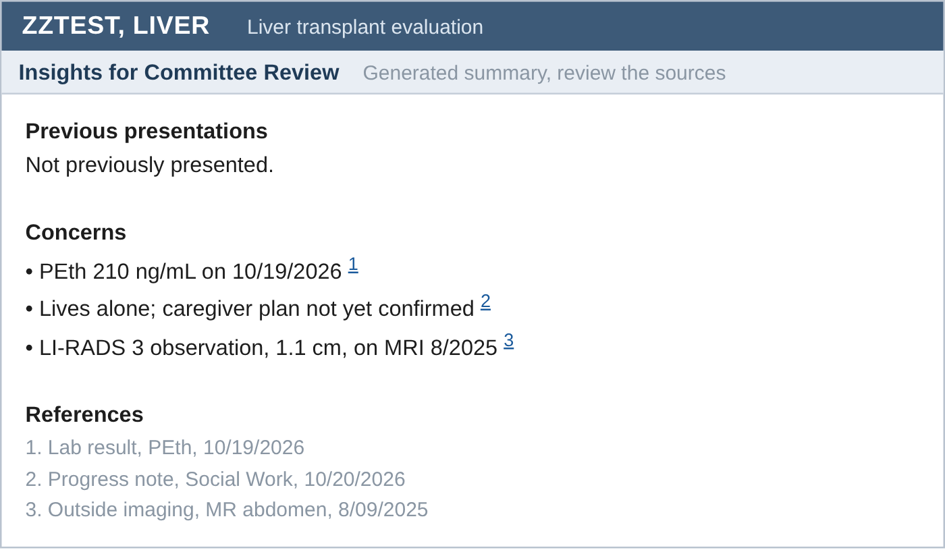
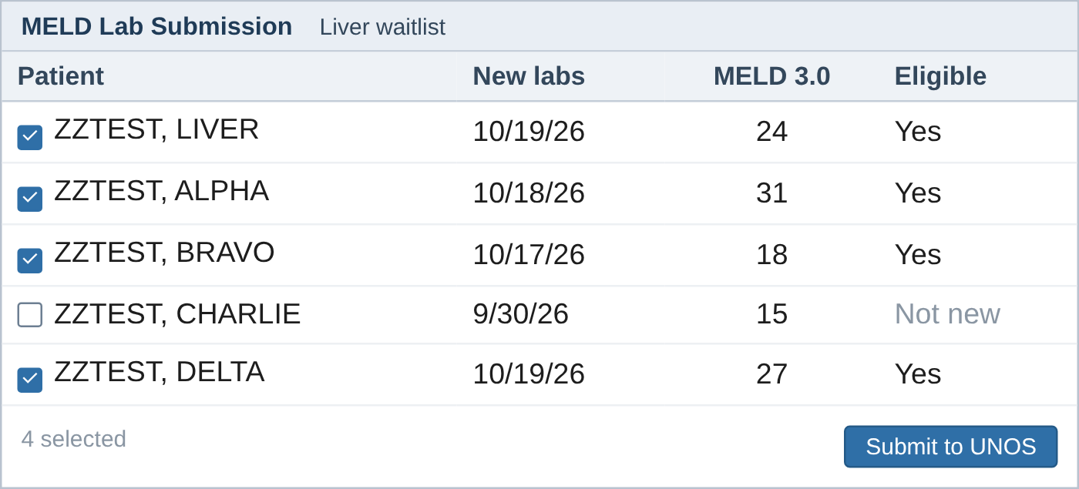
For transplant teams
AI in the chart
MELD labs to UNOS in bulk: 100 hours a year
Committee prep: 15 to 5 minutes per case
Mock-up with invented data, not a real patient or a real screen. Time savings are Epic's own estimates per transplant center (Epic UGM 2025), not studies
21/26
Notes:
Two Phoenix tools. Insights for committee review drafts the concerns for selection committee with a link to every source note; Epic estimates prep drops from 15 to 5 minutes. MELD lab submission checks which waitlisted patients have new labs and sends them to UNOS together; Epic estimates 100 coordinator hours a year for a center with about 60 liver patients listed. These are vendor numbers.

Slide 39
Where does the time go?
Measure yourself
For every 8 hours of scheduled patient care, how many hours in the EHR?
Holmgren AJ et al. J Gen Intern Med 2024;39:2868-70. Epic Signal data, 200,081 ambulatory physicians. doi:10.1007/s11606-024-08930-4
22/26
Notes:
Let them guess. 5.8 hours in the EHR for every 8 hours of scheduled patient care; notes are the biggest piece. 42% of that time happens outside clinic hours, half of it on days with no clinic at all. Not new: Sinsky 2016 found nearly 2 hours of EHR and desk work per hour with patients [PMID: 27595430], and Arndt 2017 found 5.9 hours of an 11.4-hour day in family medicine.

Slide 40
Where does the time go?
Measure yourself
For every 8 hours of scheduled patient care, how many hours in the EHR?
5.8 hours, and 42% of it outside clinic hours
Holmgren AJ et al. J Gen Intern Med 2024;39:2868-70. Epic Signal data, 200,081 ambulatory physicians. doi:10.1007/s11606-024-08930-4
22/26
Notes:
Let them guess. 5.8 hours in the EHR for every 8 hours of scheduled patient care; notes are the biggest piece. 42% of that time happens outside clinic hours, half of it on days with no clinic at all. Not new: Sinsky 2016 found nearly 2 hours of EHR and desk work per hour with patients [PMID: 27595430], and Arndt 2017 found 5.9 hours of an 11.4-hour day in family medicine.

Slide 41
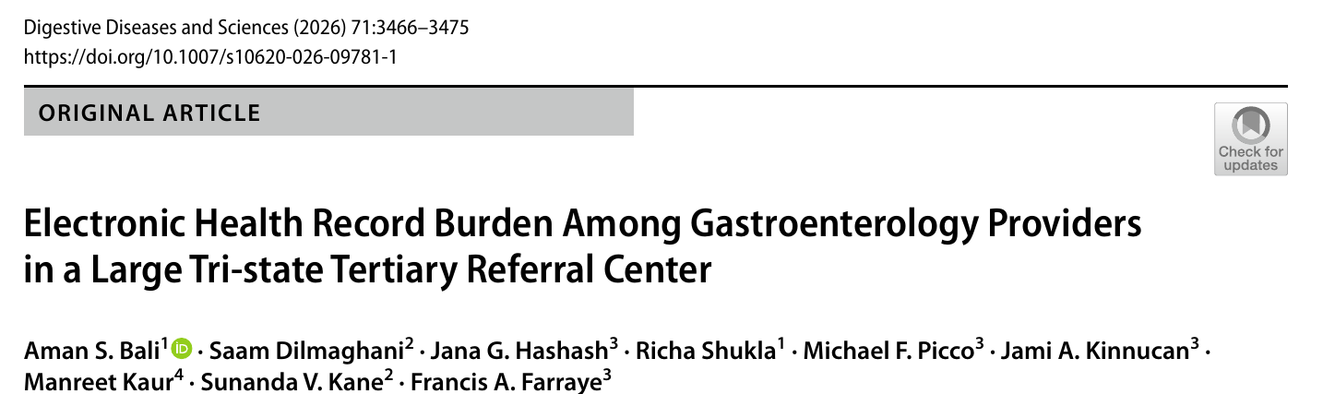
Hepatologists
Measure yourself
In Basket and documentation were the top stressors; 30.5% reported burnout
Bali AS et al. Dig Dis Sci 2026;71:3466-75. Signal data, 347 GI providers (38 hepatology), 3 centers [PMID: 41801633]
23/26
Notes:
Our own specialty. Three tertiary centers, Signal data. Hepatologists had the most EHR time per appointment of any GI group: 30.5 minutes, versus 14.7 for advanced endoscopy. That includes 8.9 minutes of chart review and 7.7 minutes outside scheduled hours per appointment. Survey: in-basket and documentation ranked as the top stressors.

Slide 42
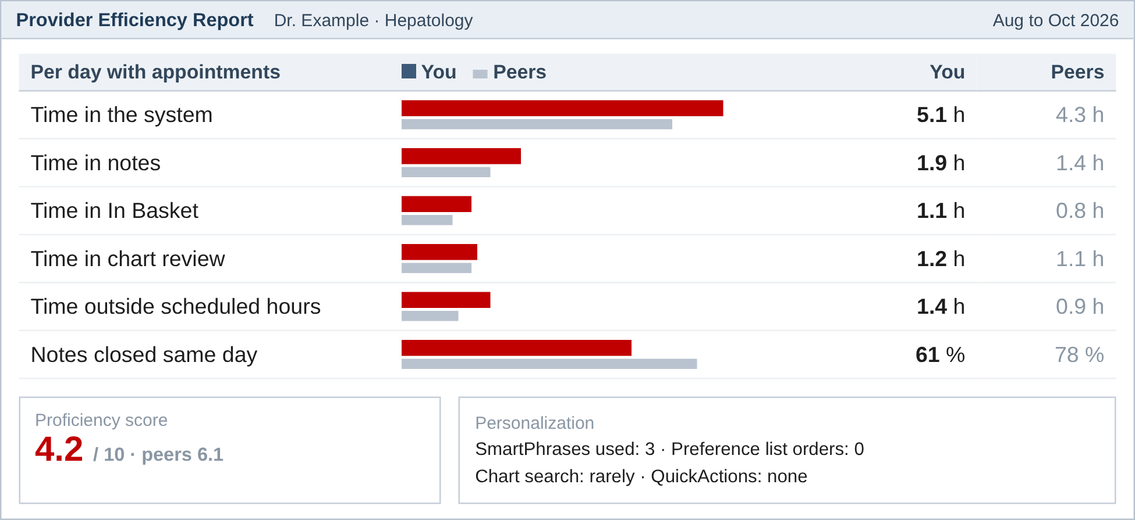
Your own numbers: Signal
Measure yourself
Your time in notes, In Basket and chart review, against your peers
Time outside scheduled hours
Which tools you use
Ask your Epic team for access
Mock-up with invented data, not a real patient or a real screen. Epic Signal Quick Start Guide and Metric Reference
24/26
Notes:
This is where the national numbers come from, and you can see your own. Dr. Example is slower than peers in notes and closes fewer notes the same day; the personalization line shows why: 3 SmartPhrases, no preference list, no QuickActions. Most of us have to request access. I did.

Slide 43
Back to our patient
Measure yourself
To set up when you get home
A Synopsis view for each kind of visit
Three saved chart searches
One SmartPhrase, yours or borrowed
Your own version of the new-patient order set
QuickActions for normal results
Look at your Signal report
Synopsis
Chart search
SmartPhrase
QuickActions
Mock-up with invented data, not a real patient or a real screen
25/26
Notes:
Back to the referral: MELD trend, workup gaps, last EGD and outside MRI, all found before walking in. None of this is AI. Pick two from the list this week. And ask which AI tools your organization has turned on.

Slide 44

Questions?
X: @mfalmeqdadi
26/26
Notes:
Hand back to Emily for the discussion.

